Slide 1

Ontario EDI 2023
Training Webinar

Slide 2


Outline
rasope@mcmaster.ca
Notes:
Outline 1
Time: About 1 hour
Questions: If you have questions during the Webinar, please feel free to send them to the EDI Coordinator at the Offord Centre for Child Studies at rasope@mcmaster.ca.

Slide 3

Outline
Early Childhood Development
The Early Development Instrument (EDI)
EDI resources
Notes:
This presentation will provide you with a brief overview about the importance of the early years and why we need to measure them, some information about the creation and importance of the EDI, as well as how to complete the EDI questionnaire online.
This training presentation is intended for teachers who are new to the EDI or have experience completing the EDI in the past.

Slide 4

Early Years Matter
They set the stage for further development
Notes:
A growing body of research on children between the ages of 0-6 years and their families is accumulating into strong evidence that the early years represent the most significant time period in an individual's lifespan.
Basic neuroscience has demonstrated that the interaction between a child’s genes and his or her early environment has a profound impact on later outcomes.
This is of significance not only for each of us individually but also to us as a society. The health of our population affects our collective social and economic well-being.

Slide 5

Early Years Matter
Child’s experiences in the early years of life influence the way the children’s genes are expressed
Child’s ability to learn when they enter school is strongly influenced by the brain development that takes place in the early years
Notes:
Children’s experiences in the early years of life influence the way the children’s genes are expressed, for example in language or regulation of emotions.
A child’s ability to learn when they enter school is strongly influenced by the brain development that takes place in these early years.
Early child development, in turn is a lifelong determinant of health, well-being, and learning skills.

Slide 6
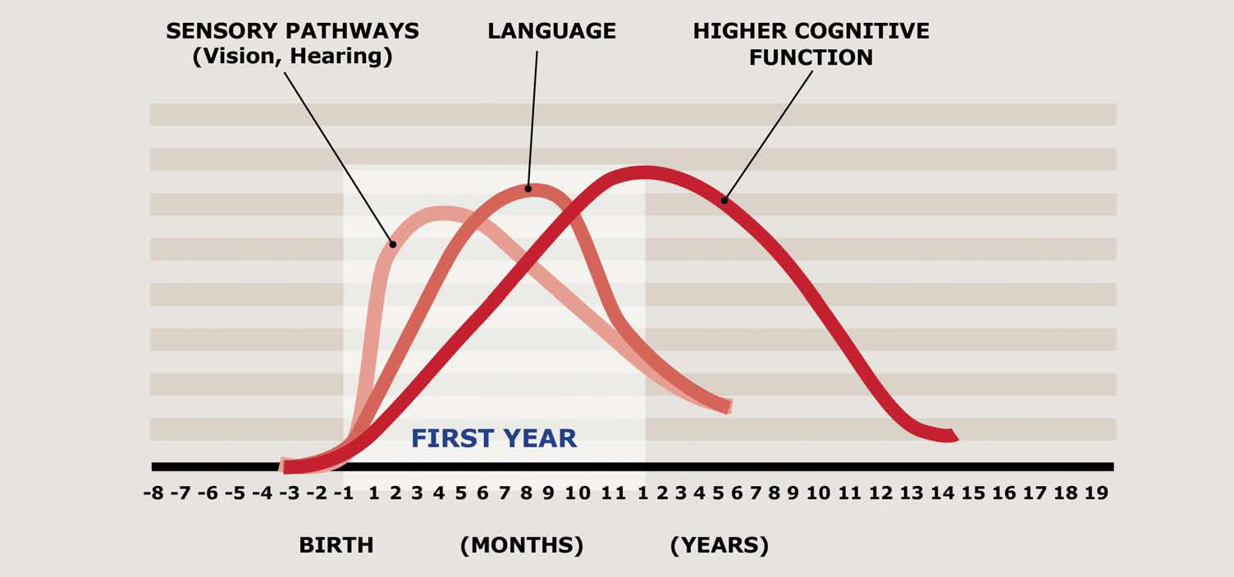
Child’s Brain
Brains are built in a hierarchical fashion, from simplest circuits to more complex circuits.
Notes:
Sensory pathways like those for basic vision and hearing are the first to develop, followed by early language skills and higher cognitive functions.
This graph illustrates the sensitive periods for different aspects of children’s brain development.
Periods of high sensitivity in all aspects peak during the first three years of life.
Brain and biological development depends on the quality of stimulation in the infant’s environment—at the level of family, community, and society.

Slide 7
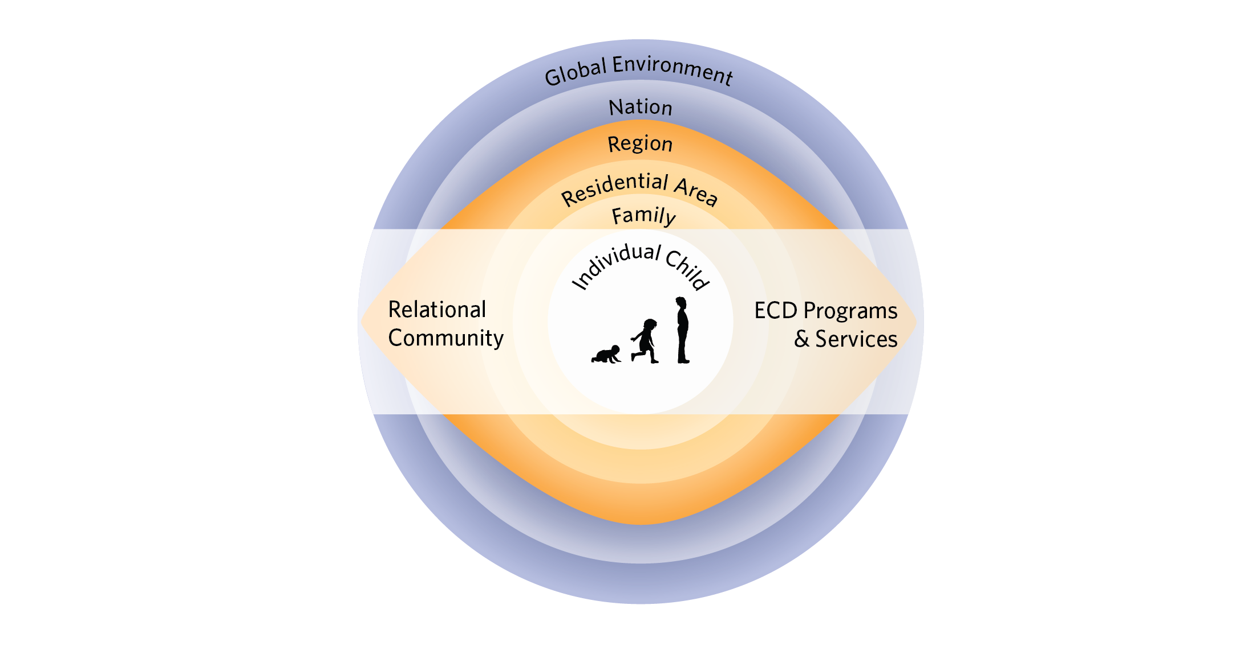
Child and family are not alone
From Hertzman, 2010
Notes:
Child and family are not alone – a lot depends on those who surround them. Both in terms of the physical and social networks and in terms of systems – such as health, education, employment – many of the factors that we call “social determinants of health”
In particular, a social determinants approach demands that we consider how social forces shape both our physical/built environment as well as the way we organize our lives, communities, school, economy and that these structural and social, political and cultural forces are particularly impactful during critical periods within the first 7 years of life – and that early life experience has a determining influence on subsequent life chances and health through skills development, education, and occupational opportunities…….”

Slide 8
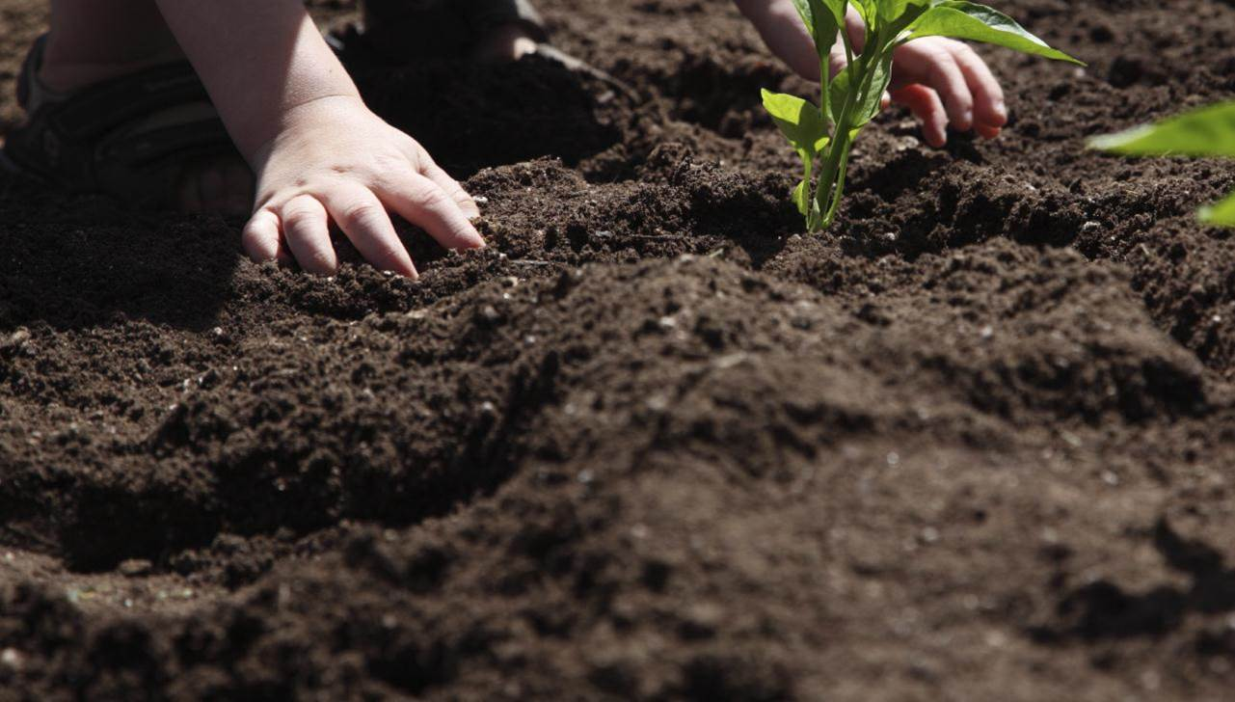
An effort in the early years when neural systems are most plastic and susceptible to influence can have long-lasting positive outcomes
Notes:
KEY MESSAGE
In summary, the early years are critical
the later you attempt to change a trajectory, such as a child’s developmental trajectory, the more energy will be required to achieve the change.
Influence children in the early years when the neural systems are the most flexible, we can achieve longer-lasting positive outcomes.

Slide 9
Why Measure?
Developmental Status
Intervention and Prevention Programs
Greatest Need
Making a Difference
Notes:
End of Early years matter section
The next section: why it is important to measure children’s developmental health.
Questions that measurement can answer:
We need to know the developmental status of our young children,
We need to know whether intervention and prevention programs help children and their families,
We need to know whether these programs are helping those at greatest need,
And lastly, we need to know whether we are making a difference in children’s lives.

Slide 10

“No Data, No Problem,
No Action”
Alfredo Solari
Notes:
No data, can’t answer the question about developmental status
Can’t identify current problems
Can’t take action to improve children’s lives

Slide 11

A large number of children at a small risk for school failure may generate a much greater burden of suffering than a small number of children with a high risk
(Based on Rose 1992, Offord et al. 1998)
Notes:
Not only is measurement important, but population-based measurement of children’s development health helps to take a temperature of how all children are doing.
By using population-based measures, we are able to highlight groups of vulnerable children that may have not otherwise been noticed.
Population based data enables us to develop universal prevention strategies that will be able to help the greatest number of children.

Slide 12

Of Canada’s kindergarten children are vulnerable
Over 27%
Notes:
Over the last decade, researchers have worked with kindergarten teachers across Canada to monitor the development of young children starting school. This population-level research shows that, today, over 27 % of children entering kindergarten are vulnerable on at least one developmental domain.

Slide 13

Why is it important:
Children who are vulnerable in kindergarten are
at least twice
more likely to experience academic and social difficulties in later grades
Notes:
We know that children who are vulnerable in kindergarten are at least twice more likely to experience academic and social difficulties in later grades

Slide 14
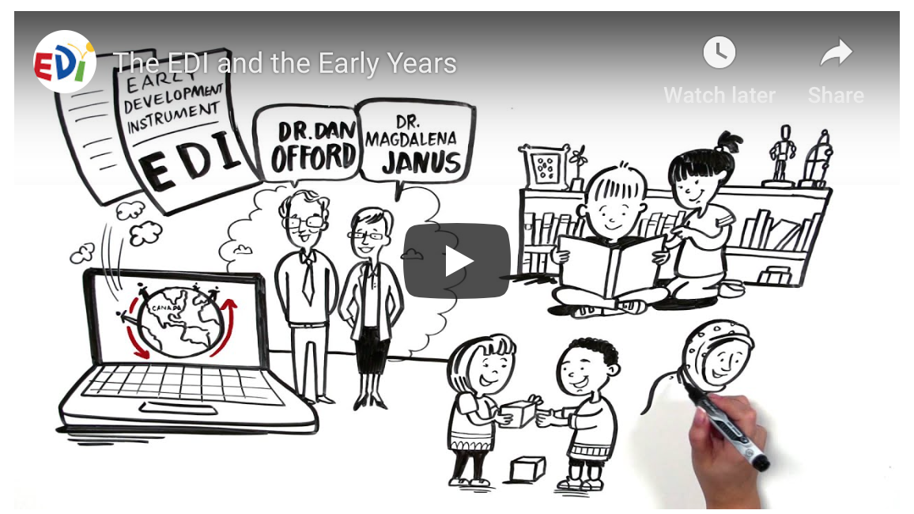

Population-level measure of child development in 5 major developmental domains
Completed by Kindergarten teachers for each child in the second half of the school year
Notes:
And this is what the EDI is meant to do.
The instrument was developed in Canada between 1997 and 2000, to measure the holistic development of each child in the population.
The EDI is completed by Kindergarten teachers for each child in the second half of the school year
The data gathered from the EDI collection allows a child development outcome to be reported at the same indicator level as birth rate or survival rate.
The goal of the EDI is to measure children’s developmental health at school entry.
This refers to the child’s ability to meet the task demands of school, such as:
being comfortable exploring and asking questions,
listening to the teacher,
playing and working with other children, and
remembering and following rules.
In short, it is the ability to benefit from the educational activities that are provided by the school.

Slide 15
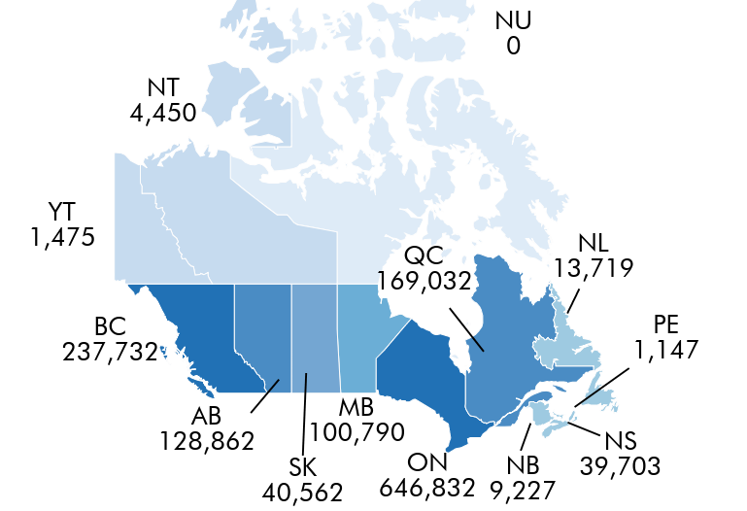
EDI in Canada
EDI Implementations in Canada
Notes:
To date, EDI data has been collected province or territory-wide in 10 provinces and 2 territories in Canada, for over 1.2 million kindergarten aged children since 2004. Many provinces and territories have had multiple EDI collections, such as NWT that has been collecting EDI data annually since 2012.
EDI data available on CIHI for 10 Provinces and 2 Territories.

Slide 16
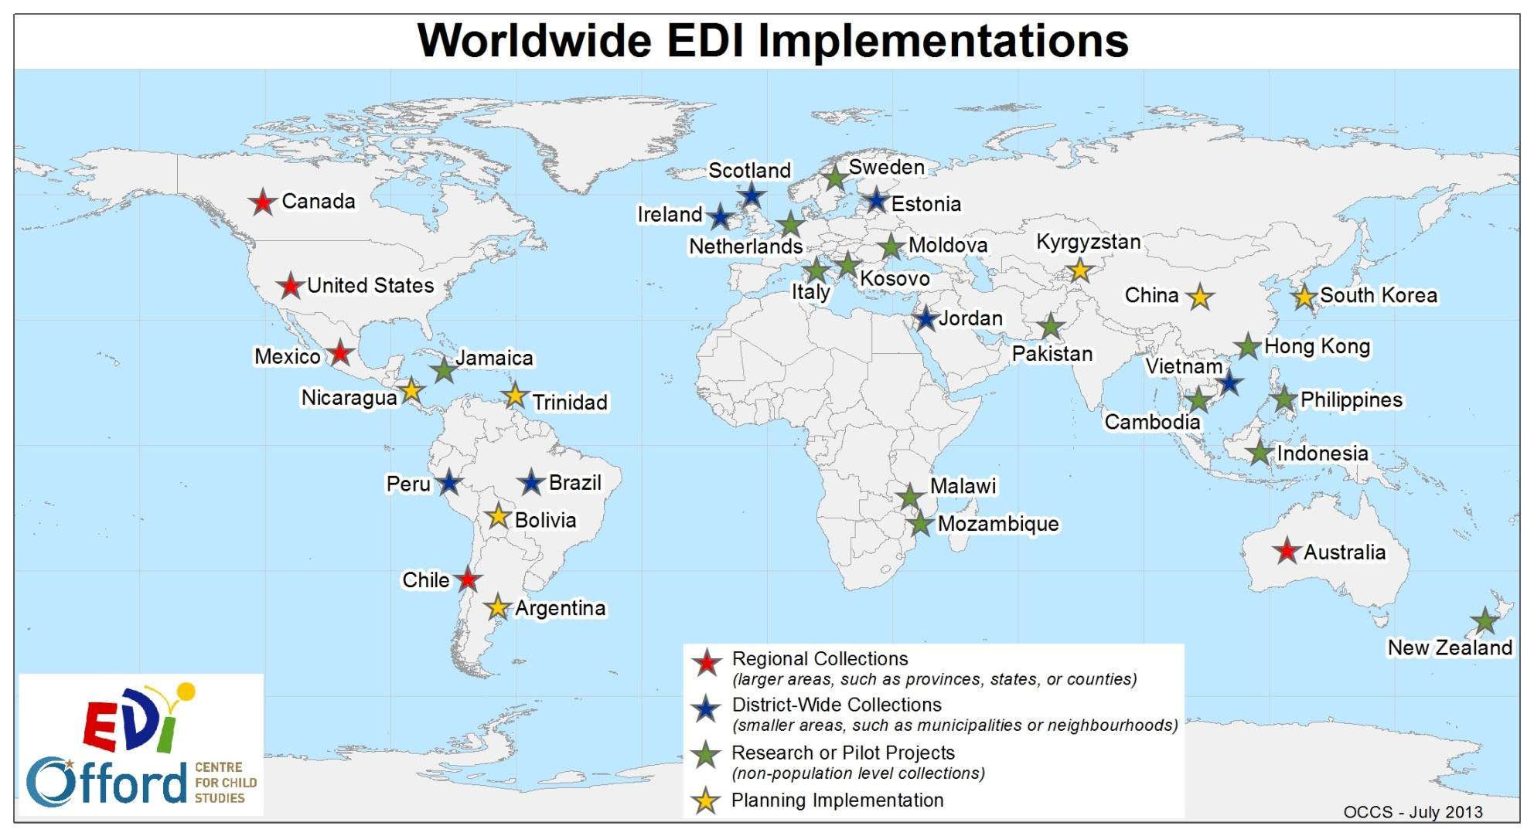
Notes:
This map demonstrates the global reach of the EDI and the countries in which the EDI has been implemented. The EDI has been collected internationally at different levels.
Example: AEDC

Slide 17

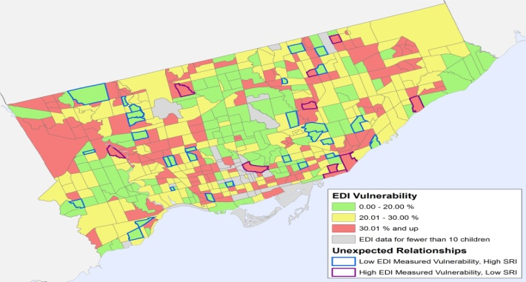

Purpose of the EDI
Purposes of the EDI
Notes:
EDI has several main purposes:
reporting on populations of children in different communities over time
identifying where the needs and strengths are greatest
predicting children’s academic success in elementary school
providing a picture of what early learning looks like at the community level, and, helping to identify gaps in early development programs and services.

Slide 18
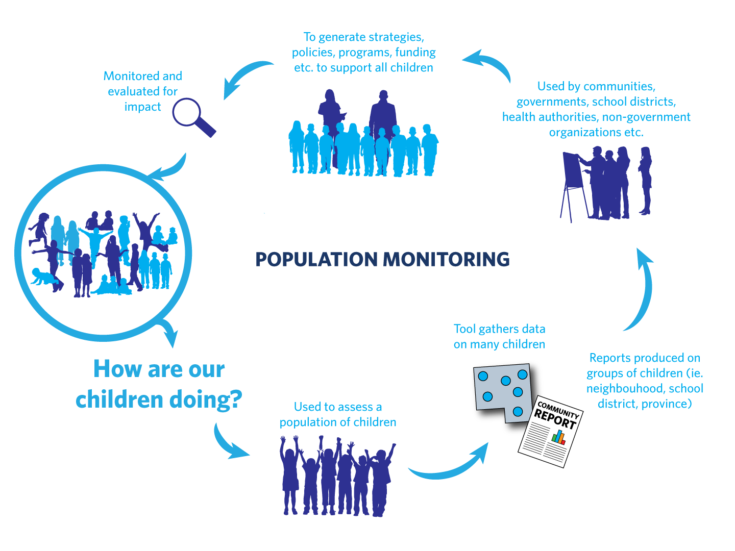
Notes:
The EDI helps to answer the question – how are we doing for our youngest population?
use the EDI to gather data on our children.
use this data to report on groups of children, such as neighbourhoods, schools, or communities.
Communities and governments use this data to generate and drive strategies, policies, programs and funding opportunities to support all children.
We then need to monitor and evaluate the impact of these strategies, therefore we complete the EDI again. And the cycle continues…

Slide 19
In terms of what we can influence
Early experiences
Developmental outcomes
Success in school
Inform
Predict
EDI results
Notes:
Through this EDI cycle, we are able to gather information about children’s experiences in the early years, monitor their developmental trajectories and outcomes, and help to predict later school success.

Slide 20
The EDI is……
103 item questionnaire
Completed by teachers
A population (or large group) measure
A way to understand trends in the development of children
The EDI is not…..
An individual child or diagnostic measure
A way to evaluate teachers
Notes:
The EDI is a:
103-item questionnaire that is completed by teachers.
tool to measure children’s development health at a population or group level, and
it gives the opportunity to understand the changing trends that are occurring.
The EDI is not:
a diagnostic measure and should not be used for an individual child assessment.
evaluation of teachers.

Slide 21





EDI Domains
Physical Health and Well-Being
Social Competence
Emotional Maturity
Language and Cognitive Development
Communication Skills and General Knowledge
Physical Readiness for the School Day
Physical Independence
Gross & Fine Motor Skills
Overall Social Competence
Responsibility and Respect
Approaches to Learning
Readiness to Explore New Things
Prosocial and Helping Behaviour
Anxious and Fearful Behaviour
Aggressive Behaviour
Hyperactive and Inattentive Behaviour
Basic Literacy
Interest in Literacy/Numeracy
Advanced Literacy
Basic Numeracy
Communication Skills and General Knowledge
Notes:
The EDI is has 103 core items that measure children’s ability to meet age-appropriate developmental expectations in five general domains.

Slide 22
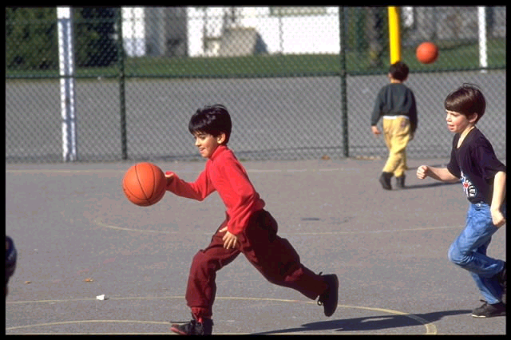
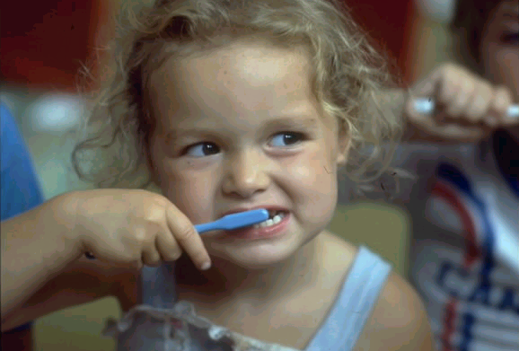
Physical Health & Well-Being
Subdomains:
Physical readiness for school day
Physical independence
Gross and fine motor skills
Notes:
The EDI assesses children’s developmental health when they enter school by looking at five key areas of child development. These five subdomains are also further broken down into 16 subdomains.
Physical Health & Well-being
Physical readiness for school day (including arriving to school hungry)
Physical independence (established hand preference)
Gross and fine motor skills (being able to manipulate objects)

Slide 23


Social Competence
Subdomains:
Overall social competence
Responsibility and respect
Approaches to learning
Readiness to explore new things
Notes:
Social competence
Overall social competence (ability to get along with peers)
responsibility and respect (follows rules and instructions)
approaches to learning (listens attentively)
readiness to explore new things (curious about the world)

Slide 24
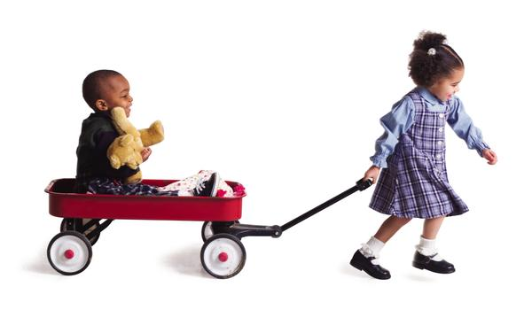

Emotional
Maturity
Subdomains:
Prosocial and helping behaviour
Anxious and fearful behaviour
Aggressive behaviour
Hyperactivity and inattention
Notes:
Emotional Maturity:
Pro-social and helping behavior (try to help someone who has been hurt)
Anxious and fearful behavior (upset when left by parent)
Aggressive behavior (gets into physical fights)
Hyperactivity and inattention (can’t sit still, restless)

Slide 25


Language & Cognitive Development
Subdomains:
Basic literacy
Interest in literacy/numeracy and memory
Advanced literacy
Basic numeracy
Notes:
Language and Cognitive development
Basic literacy (ability to handle a book)
Interest in literacy and numeracy, and memory (able to remember things easily)
Advanced literacy (able to read simple words)
Basic numeracy (able to count to 20)

Slide 26


Communication Skills & General Knowledge
Subdomain:
Communication skills & general knowledge
Notes:
Communication Skills and general knowledge and it is the only domain that only has one subdomain, which is also called communication skills and general knowledge.
Items in the domain include such things as skills to communicate needs and wants in socially appropriate ways, symbolic use of language, story telling, age-appropriate knowledge about the life and world around.

Slide 27
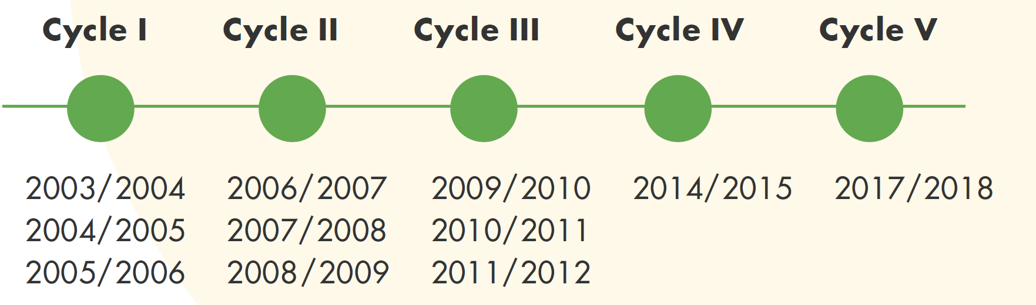

EDI in Ontario
Notes:
To provide some local context, I’m now going to present some results from the past EDI collections in Ontario.
As you may already know, there have been 3 provincial collections in Ontario so far, with the fourth provincial collection happening this year. The first cycle, which we also refer to as the Ontario Baseline, is what we use to determine the cut-points for determining vulnerability.

Slide 28
Ontario Cycle I-V Vulnerability
Notes:
This graph demonstrates the vulnerability rates for each domain, as well as overall vulnerability for each provincial cycle. For those of you who are new to the EDI, a child is considered vulnerable on a particular domain when they score below the 10th percentile cut-point for that domain. The cut-points are based on the Cycle I or Baseline population distribution. Overall vulnerability is when a child falls below the 10th percentile cut-point for at least one domain.

Slide 29

The Early Development Instrument
(EDI)
e- Teacher Information & Training Session
Notes:
The second part of this video is designed to provide teachers with the necessary information in order to complete the EDI.
This training session is intended for teachers who have never completed the EDI before, as well as for those who have.
If, along the way, you have any questions, an email address will be provided at the end of the video. Do not hesitate to contact us.

Slide 30


Overview
Information about the e- process
How to complete the online questionnaire
Notes:
The main goal of this Presentation is to provide information on how to complete the e-EDI.
This presentation is divided into two main sections.
The first section covers some general information about the e-EDI process
second section will cover the online completion of the questionnaires, section by section.

Slide 31
Getting Started
Teachers need to the following resources in order to complete their EDI questionnaires
  Local class list
  e-EDI Teacher log-in & password
  EDI Guide
  e-EDI Teacher Manual
Notes:
School Board coordinators will have a master list of all teachers login and password information. School Board Coordinators will provide teachers with a local class list which will contain the demographic information for each student as well as their local identification number and their first and last names. Teachers will use this class list to match up students with the e-EDI class list to ensure that teachers are completing the questionnaire for the correct student.
Teachers receive an e-EDI teacher log-in and password included on their individual class list file.
The late two resources, are the EDI Guide and an e-EDI teacher’s manual.

Slide 32


EDI Guide & Teacher’s Manual
They are intended to facilitate completion of the
The Manual provides steps to guide the on-line completion of the questionnaires
The Guide provides more detailed information about each question in the
Notes:
The EDI Guide and teacher’s manual are intended to facilitate completion of the EDI and should be read before starting the completion of the EDIs.
The Teacher’s manual provides steps to guide you through the online completion of the EDI questionnaires, while the Guide provides more detailed information about each question within the EDI. These are two very useful tools to help you complete the questionnaires more efficiently and more accurately.

Slide 33


Before You Begin the e-EDI
Receive your training!
Get your login & password
Review the questions
Have your class list handy
Ensure that all the children in your class(es) have a local ID & are included on your list
Review any background materials (e.g.
Guide, Teacher’s Manual)
If applicable, list students whose parents/guardians have refused to participate
Notes:
Before you being completing the EDI on your students, you will need to receive training on how to complete the questionnaire.
You will also need to get your login and password. Your local coordinator will provide you with a login and password for the e-EDI system when you are given the EDI package.
Please make sure to review the EDI questions and ensure that you feel reasonably comfortable with the questions that will be asked about each student.
Have your class list available. Please make sure to have your class lists with you when you start completing the EDI, in order to match your students’ local IDs, gender, and birth dates to confirm that you are entering information for the correct student.
Ensure that all the children in your class(es) have a local ID and are included on your list. If any students are missing, they will need to be added.
Review any background materials, such as report cards, student file, Kindergarten Registration or other information that might help you to answer the questions for each student. Also, please make sure you read the EDI Guide and the e-EDI teacher’s manual. As mentioned in the previous slide, these materials will help you complete the EDIs more efficiently and more accurately. Also helpful to have absenteeism list.
If applicable, list students whose parents/guardians have refused to participate. Letters will be sent to parents ahead of the scheduled time for EDI data collection.

Slide 34


Tip #1
Read the entire Guide once before starting on the questionnaires
After having read the Guide, please consult it if you have any doubts about a given question
Have the e- Teacher’s Manual with you when completing the questionnaires
Notes:
Tip #1: Please ensure you read the entire EDI Guide once before starting on the questionnaires. That way, if you have any questions about anything, you will be able to get answers to them before starting.
Also, please have the e-EDI teacher’s manual with you when completing the questionnaires. It provides step-by-step instructions on how to complete the questionnaires using our online system.
Having these documents with you will help the whole process run more smoothly.

Slide 35
Implementation Timelines & Deadlines
Teachers receive e-
training
Teachers complete the questionnaire online
Teachers lock & submit each child’s questionnaire as they are completed
Today!
May 31st
May 31st
Notes:
Here is a timeline for EDI completion. Teachers will have until May 31st to have all of their EDI questionnaires locked and submitted to the Offord Centre.

Slide 36


Time
About 20 minutes per questionnaire
After completing a few, it should take closer to 10 minutes per questionnaire
s for best students and struggling students are completed more quickly… middle ground students require more thought.
Notes:
It should take you approximately 20 minutes to complete the questionnaire, per student.
After completing the EDI for a few students though, it should take closer to 10 minutes per student.
Based on teacher feedback we have received, you will most likely complete the EDI in less time for your best students, as well as for those who are struggling. The students who are in the “middle ground” will most likely require more thought and as a result will take longer to complete.

Slide 37

General Instructions
Responses should be based on your observations of the students which reflect his/her current developmental status.
Exception: Section C
  Responses should be based on observations of the students now, but using the time since the beginning of the school year as a frame of reference.
Notes:
When completing the EDI, please keep in mind that your responses should be based on your observations of your students which reflect their current developmental status.
The only exception is Section C. Your responses should be based on your observations of the child now, but you should use the time since the beginning of the school year as a frame of reference.

Slide 38

General Instructions
Use “Don’t know” as a last resort.
Questionnaires received with too many ‘I don’t knows’ cannot be used in the analyses.
If you have not seen a child exhibit a particular behaviour, select Never or Not True (not “Don’t Know”)
Notes:
Please refrain from using the “don’t know” response.
Questionnaires received with too many “I don’t knows” will not be considered valid and will be excluded from the analyses.
If you have not seen a child exhibit a particular behaviour since the beginning of the school year, the correct answer is Never or Not True (and not Don’t Know)

Slide 39
Tip #2
Due to the “learning curve” involved, it is considerably more efficient to complete all the questionnaires in one sitting*
* One sitting may involve 2 or 3 consecutive days, depending on the number of students you have
Notes:
Due to the “learning curve” involved in completing the questionnaires, it is considerably more efficient to complete all the questionnaires in one sitting.

Slide 40



Tip #3
Encourage teachers to “think like researchers”
Notes:
Based on focus groups that our team has held with teachers, we know that teachers’ positionality and their in-depth knowledge of children’s lives impact how we view children's experiences and abilities. For the purposes of the EDI questionnaire, we want to encourage teachers to “think like researchers”, and simply report their observations of children’s abilities in the classroom.
This is also an opportunity for school boards/divisions to engage their Equity, Diversity/Inclusion representatives from the school board in EDI training,

Slide 41



Tip #4
EDI Reports, Data, and
Collaboration
Notes:
A great strategy to get teachers engaged in the EDI process is to put the EDI reports from previous collections in their hands. Based on teacher feedback, many teachers don't know where EDI results end up or how they are being used. Giving teachers EDI Reports from previous collections shows them how their hard work and dedication pays off.
School boards/divisions can also incorporate examples into their training sessions as to how EDI data is used at a school board level.
This is a great opportunity for boars to communication how they engage with other entities such as the municipalities/DACs or community agencies to use EDI data to create better lives for children in their classrooms. All of these strategies will help teacher engagement throughout the EDI process.

Slide 42

How to complete the e- questionnaires

Slide 43


Accessing the e-EDI
In your Internet browser type in:
www.e-edi.ca
Notes:
To access the e-EDI, type in www.e-edi.ca in your Internet browser (such as Internet Explorer, Google Chrome, Firefox, etc). You may even want to bookmark it for the future. The EDI questionnaires can also be accessed on mobile devices such as cell phone or tablets

Slide 44
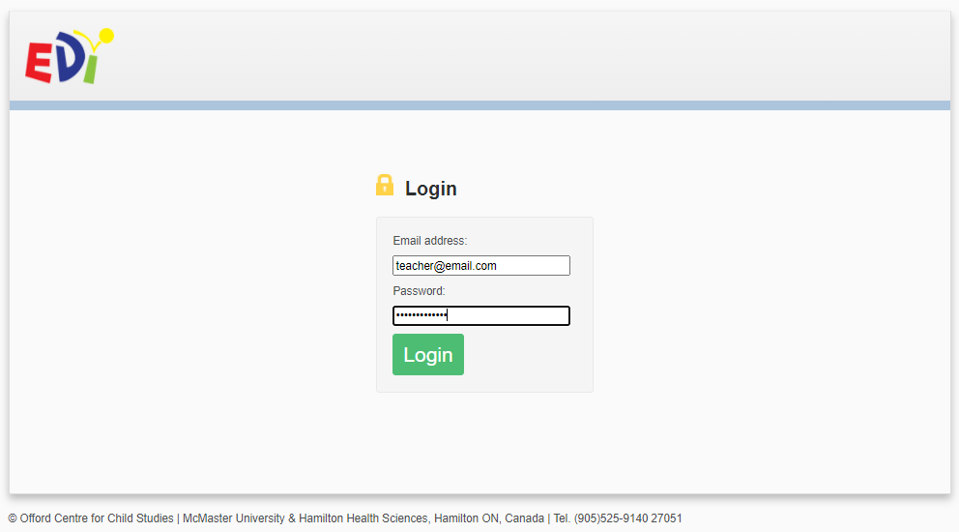
Signing In
Teacher’s email here
Teacher password provided on class list
Notes:
Using the login and password information that was provided to you, enter the information in the appropriate fields.
Click the login button or hit the Enter key to log in.
Once you are logged in, you have the option of changing the language from English to French.
Also, once you are logged in, you will only be able to see your own classes and students' information. You will not have access to other teachers’ class lists and they will not be able to access yours.
If teachers co-teach a class, it is recommended that only one of the teachers complete the EDIs for all their students. The reason for this is to try and keep things as consistent as possible.

Slide 45
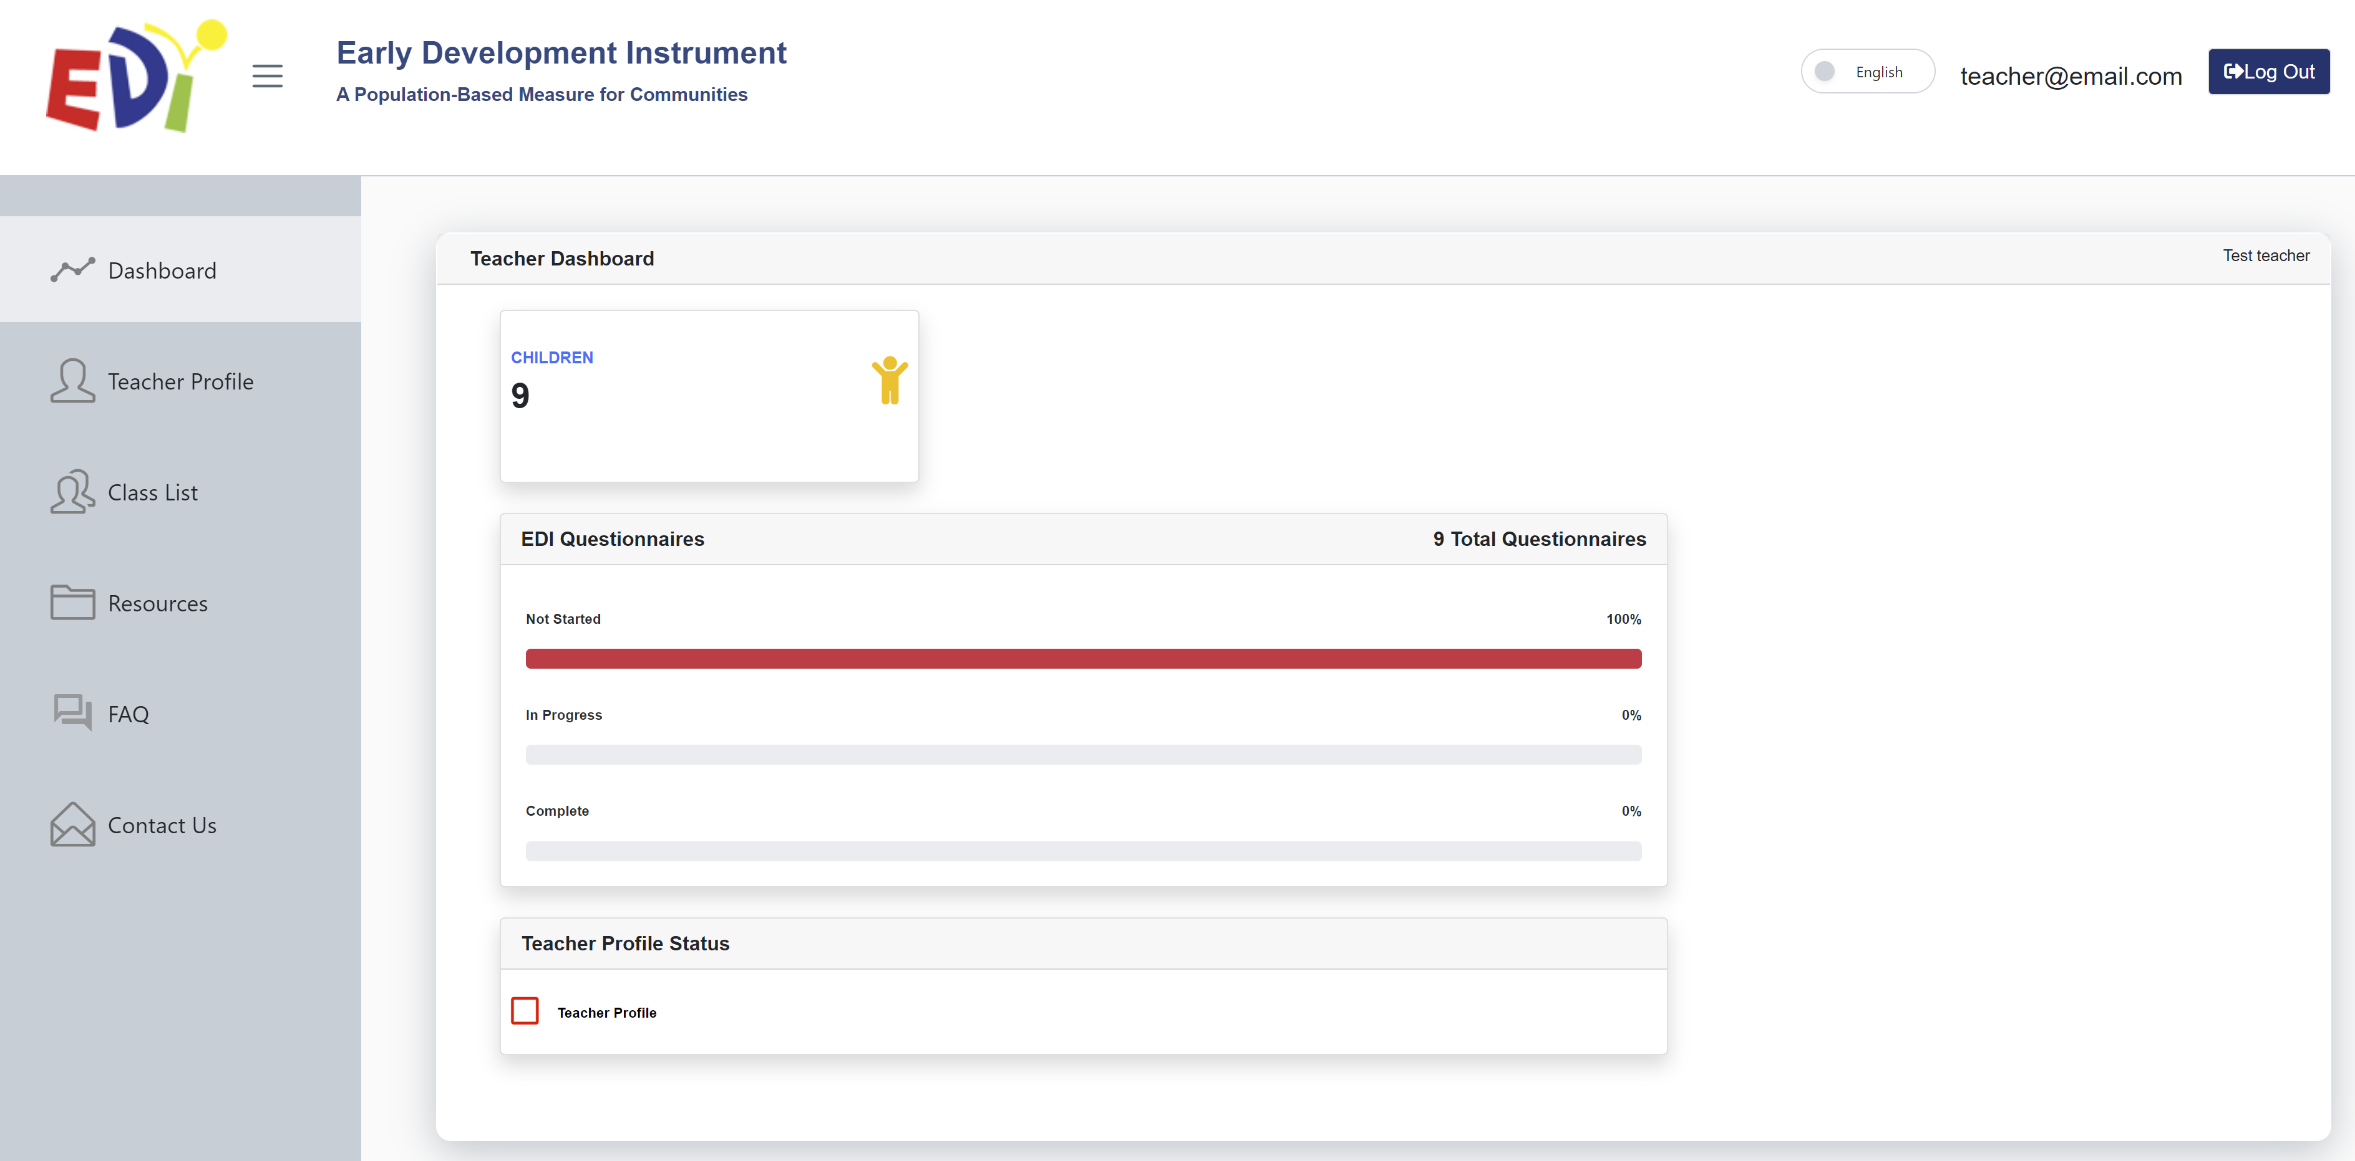
Teacher Dashboard
Notes:
After logging in, this is the screen that will appear – it is your Teacher Dashboard. On the Dashboard you can see how many EDI questionnaire you have, and a quick glance of how many EDIs have not been started, are in progress, or are completed.
There are 6 main areas, and I will bring your attention to 3 of them.
On the left-hand side under Teacher Profile, you can complete the Teacher Profile Form. You can also see the status of your Teacher Profile form on the dash board.
Under Resources you will find a link to an electronic copy of the EDI Guide and e-EDI Teachers manual. Please make sure to read through it before starting to complete the questionnaires.
To start completing the EDI, select Class List.

Slide 46
EDI Questionnaires
Click here to access your class list & questionnaires
Notes:
To get started on your EDI questionnaires, click on Class List from your Dashboard. This will bring you to your class list(s) and questionnaires.

Slide 47
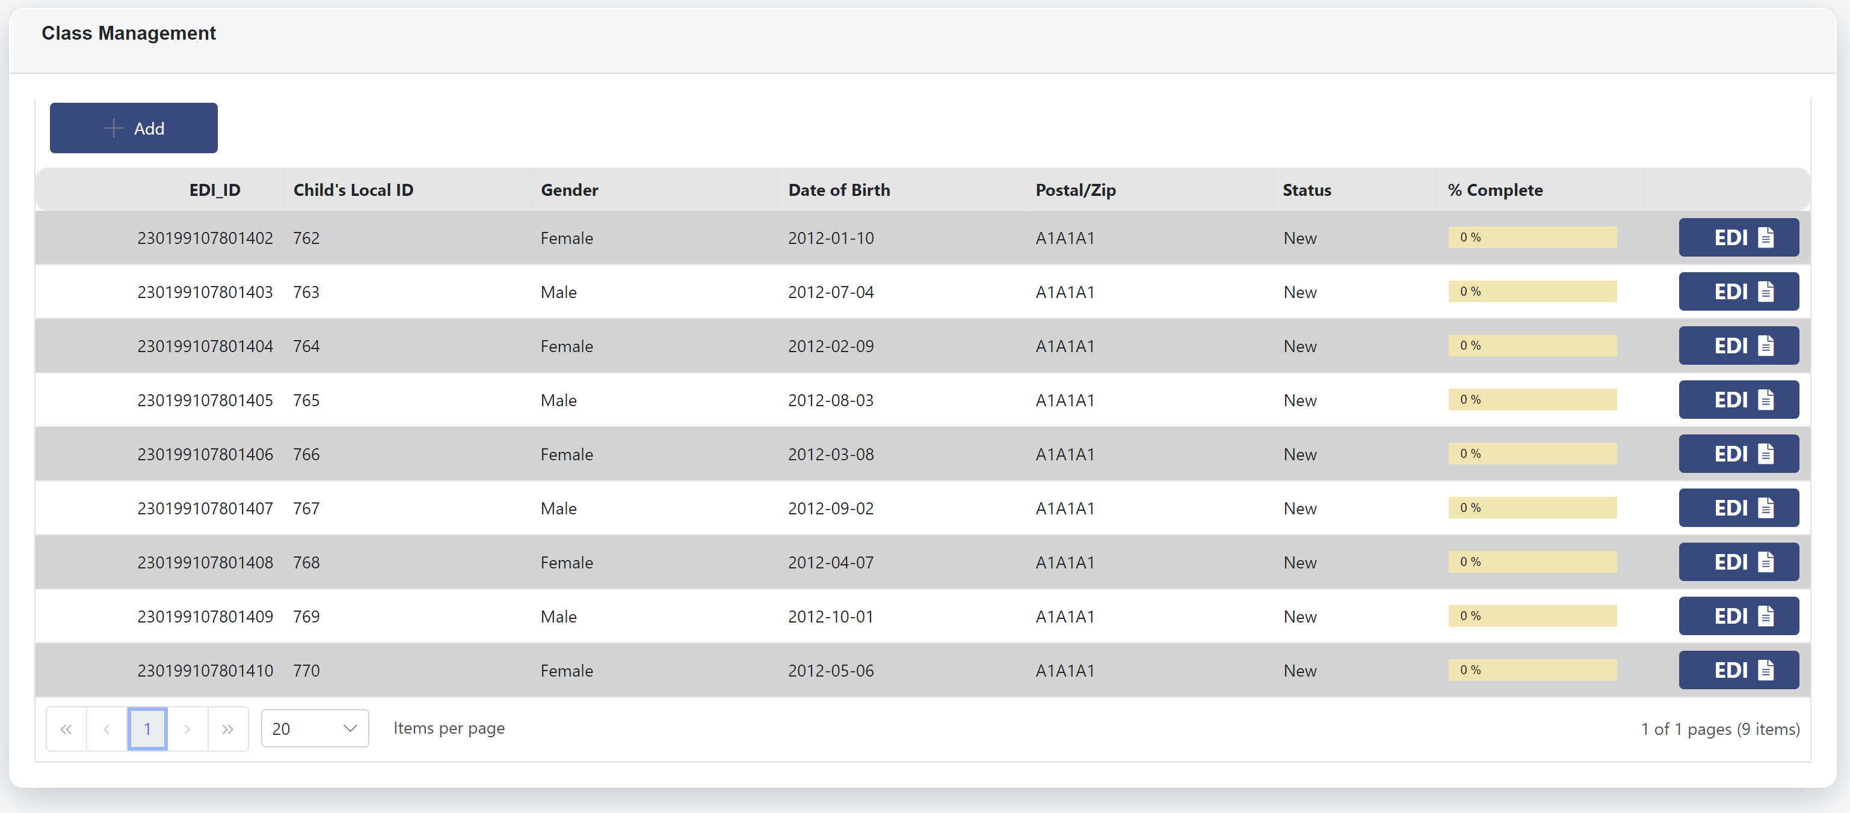
Class list(s)
Notes:
After clicking on Class List, you will be redirected to your class list page.

Slide 48
Step 1: Identify the Child
Match the corresponding Local ID with the Local class list (which contains children’s names) to ensure you are thinking about the right child.
** For privacy issues, the children’s names do not appear anywhere on the questionnaire
Notes:
Your class list allows you to see each student’s EDI ID as well as their local ID, their gender, date of birth and postal code.
No student names appear on the e-EDI class list.
Using your local class list (which contains children’s names) and the e-EDI class list, match the corresponding local ID to ensure you complete the questionnaire on the correct child.
For privacy reasons, children’s names do not appear anywhere on the questionnaire.

Slide 49
Entering into the Questionnaire
To access a questionnaire, select one of the flashing blue EDIs on the right-hand side of the screen.
Notes:
To complete a questionnaire for a student, click on the flashing blue EDI icon located on the right-hand side of the screen.

Slide 50
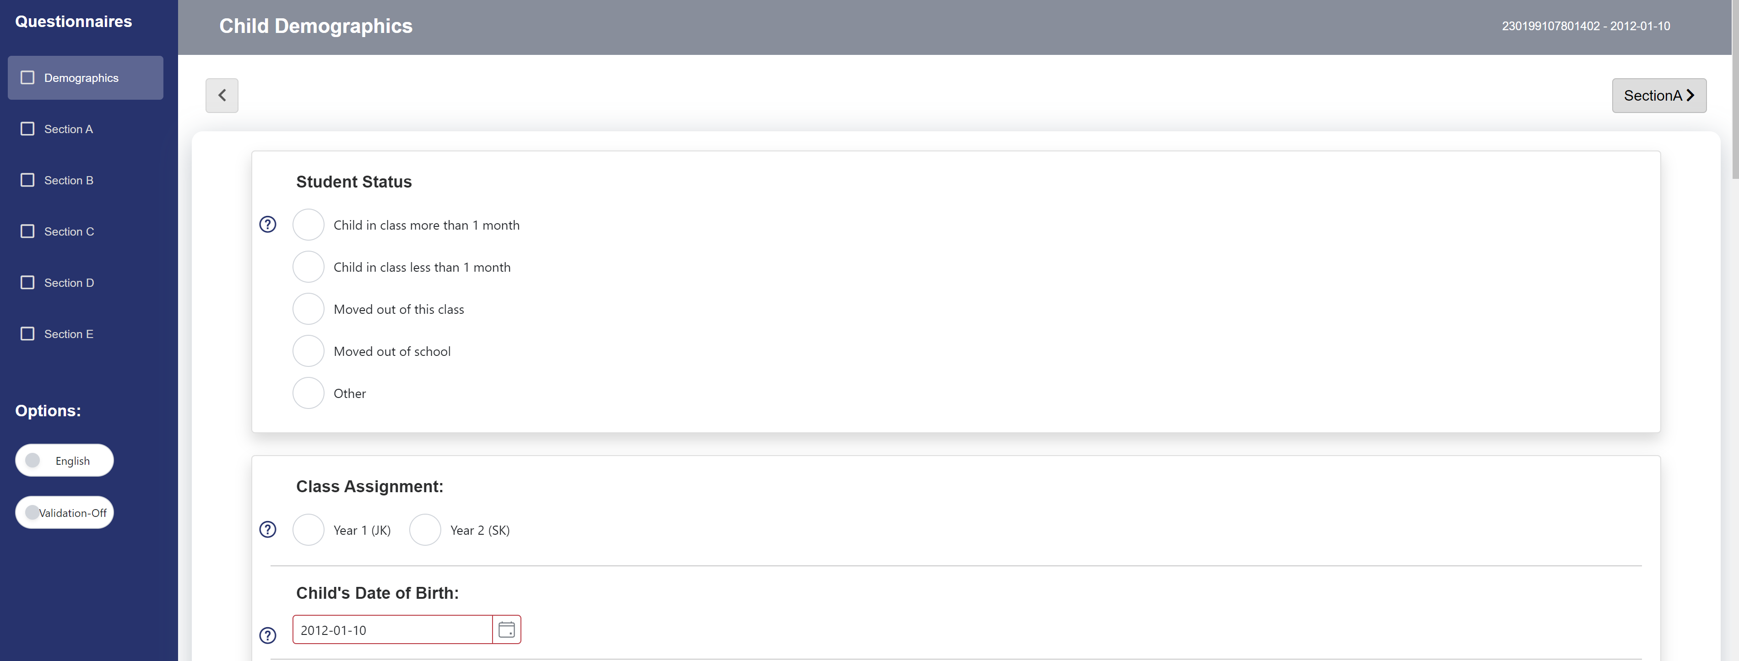
Child Demographics
* For province/territory-specific questions, please refer to your Guide
Notes:
In this section, there are a few questions should already be prefilled (with the exception of newly added students, which we will get to later in the presentation).
For the remaining questions, please select the appropriate response.

Slide 51
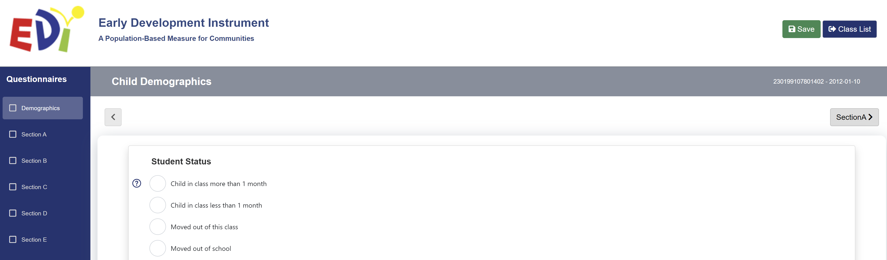
Missing or Incorrect Information
If any of the information is incorrect or missing, enter the correct information in the Child Demographics section
Click Save EDI
Notes:
Please ensure the demographic information is correct (especially for the prefilled questions).
In the event the information for a given question is incorrect or missing, please enter the correct information and click on Save EDI.

Slide 52
Sections A-E of the EDI
To access a specific section of the EDI, click on one of the sections listed in red on the left of your screen
Notes:
To access the various sections of the EDI, all you need to do is click on one of the section headings listed on the left of your screen, or move to the next section clicking the Section button on the top (or bottom) of your screen.

Slide 53
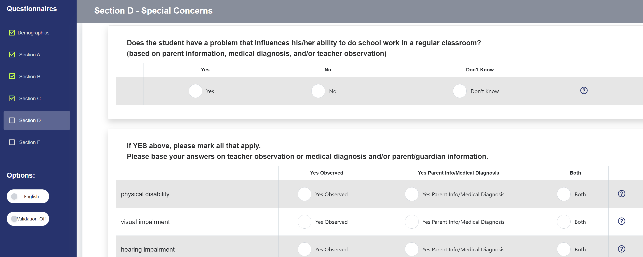
Sections A-E of the EDI
Complete Sections A to E by selecting the appropriate response for each question
Notes:
Complete each section of the EDI by selecting the appropriate response for each question.
If you are unsure about what a question is referring to, please consult the EDI Guide by clicking the Help button.
If you want (or need) to change your answer, you can do so by clicking on another option or to remove a response, double-click the bubble.

Slide 54
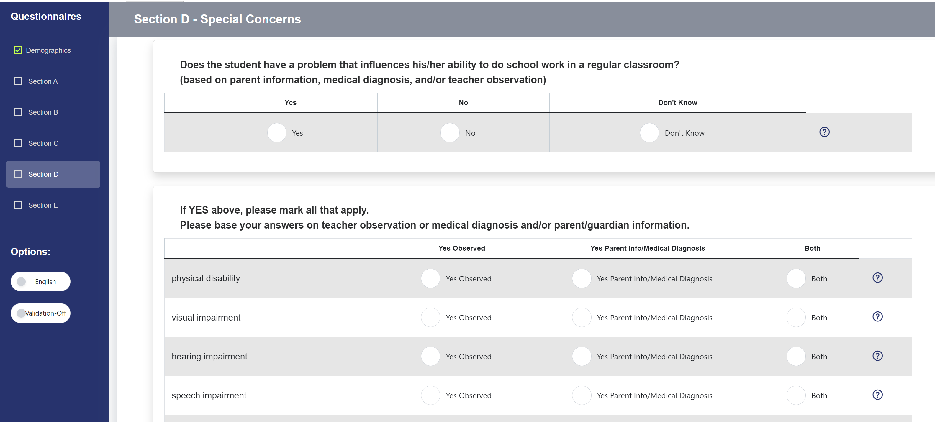
Section D
Notes:
Section D refers to any special concerns about a particular child.
Please refer to your Guide for the definition.
Please note that you may choose more than one answer in question 2. However, your answers to question 2 must be consistent with your answer in question 1.
If you have responded that the student has a problem that influences his/her ability to do school work in the classroom by selecting « yes » to the 1st question, you must select at least 1 of the special concerns in question 2. Please answer these questions to the best of your abilities.
If you have selected an impairment that the child has, simply double-click the bubble to remove that selection

Slide 55
Section E
Answer these questions to the best of your knowledge
Use data from the students’ records, if available
If you don’t know the answer to the questions, please indicate “don’t know”
Notes:
Section E includes questions related to children’s pre-school experiences.
For these questions, please answer to the best of your knowledge.
Feel free to use data and information from the students’ records, if available.
In the event you don’t know the answer to a question, you can certainly select “don’t know”.
Unlike the other sections, selecting “don’t know” in section E will not render your questionnaire invalid.

Slide 56
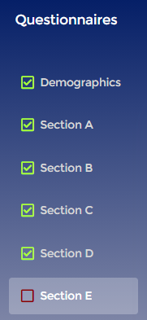
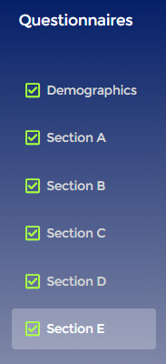

Finishing & Checking
Before clicking Lock Questionnaire, if the system tells you:
Go back to incomplete
sections and fill in
any answers you missed
You are done!
Click
here
Notes:
When you believe you are done, the Section headings on the left-hand side will either indicate that you have some sections that are incomplete (indicated by red boxes) or that all sections have been successfully completed (indicated by green boxes with check marks).
In the event of incomplete sections, you will need to go back and answer and questions you may have missed. To do that, simply click on the corresponding section.
If you have successfully completed all sections, you are now done and can click Lock Questionnaire at the end of Section E.

Slide 57
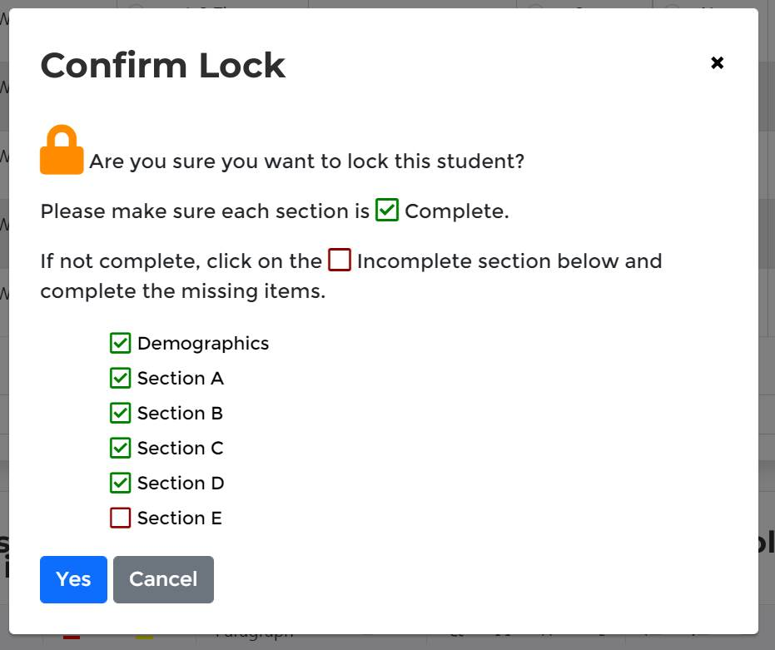
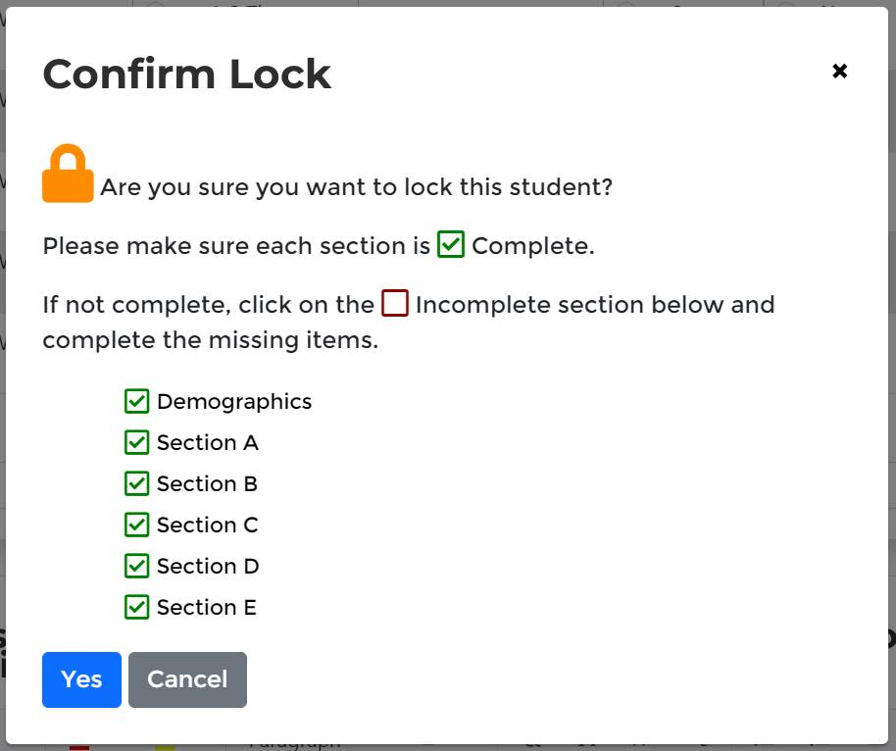
Locking a Questionnaire
You will get a message asking you if you are sure you want to continue with locking a questionnaire
You will get a reminder to ensure that all sections are completed
Incomplete Questionnaire
Complete Questionnaire
Notes:
Once you click on Lock Questionnaire, a message will appear asking you if you are sure you want to continue with locking the questionnaire.
The message also indicates if all sections are completed using a green checked box or a red square.
You can click on the incomplete section within the message box in order to return to that section and complete any missing items

Slide 58
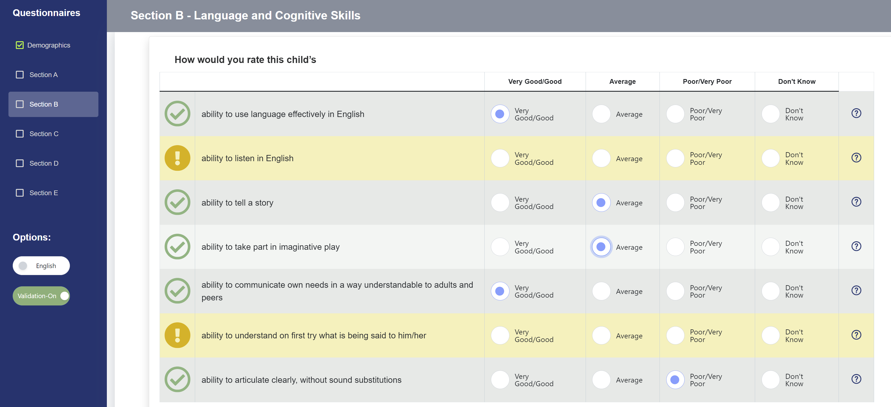
Tip #3
Notes:
Under the Section headings on the left hand side, you will see these 2 very important Option tabs.
You can select the language you wish to work in, French or English, by switch the Language Toggle at any point throughout the questionnaire.
Second, by switching the Validation Toggle to “on” you can see which questions within a given section have been left incomplete. The completed questions are green with a check mark and the incomplete are red with an x

Slide 59
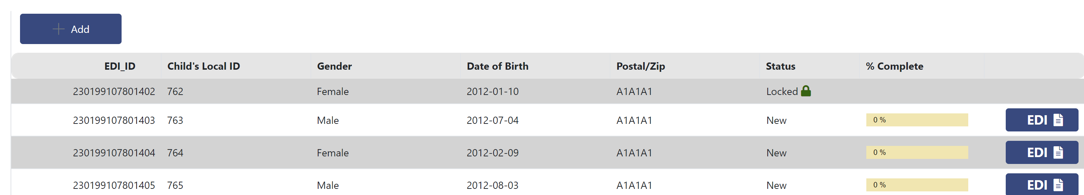
Locking a Questionnaire
If all sections are completed, click YES
You will be returned to the Class List page
Notice how a Locked now appears beside the completed
Notes:
If all sections are completed, click Yes. By doing this, you will be redirected to the Class List page where you can select another EDI questionnaire to complete.
Notice how the word Locked now appears beside the completed EDI, under the Status column.
You will be able to tell which questionnaires you have locked and submitted this way.
All those without “Locked” next to the flashing EDI still need to be completed and submitted.
Please note that once you lock a questionnaire you cannot reenter it without contacting Offord Center for permission.
Don’t forget that you will have to do this for each student in your class. Clicking Lock Questionnaire after the last questionnaire will only submit that questionnaire and not the whole class.

Slide 60

Tip #4
Continuously save as you work!
After 15 minutes of inactivity you will
automatically be logged off the system and all your unsaved changes will be lost
Notes:
Please remember to continuously save as you work. Similar to bank websites, after 15 minutes of inactivity, you will automatically be logged off the system and all your unsaved changes will be lost.

Slide 61

Please Pay Special Attention to the Following Questions
Notes:
We will now identify specific EDI questions which require special attention.

Slide 62


Student Status Question
Students must currently be in your class to do the
If you have selected a
response other than “In class more than a month”…
… the system will tell you to
stop and lock and submit your questionnaire
Notes:
The student status questions is where you can identify students who are no longer in your class.
Students must currently be in your class to have the EDI completed.
If you have selected a response other than “in class more than a month”, the system will tell you to stop, lock and submit your questionnaire
You will not be required to complete the rest of the questionnaire for that student.

Slide 63
Identified Special Needs
Identified Special Needs cannot be left blank!
Please refer to your Guide for further instructions
Yes | No
Child identified already as needing special assistance due to chronic medical, physical, or mental disabling conditions, e.g., autism, fetal alcohol syndrome, Down syndrome Child requires special assistance in the classroom | * * Gifted or talented * * Please mark, instead, their special talents in Section B, questions 34-39 If you only suspect that the child may be suffering from a disabling condition, or the condition is not severe enough for the child to be classified as “special needs.” (Please indicate the problem in Section D of the questionnaire.)
Notes:
This question, located in the Child’s Demographics page must not be left blank.
If left blank the entire questionnaire will be omitted from analysis.
As a general guideline, you would respond yes to this question if the child has already been identified as needing special assistance due to chronic medical, physical or mental disabling conditions or requires special assistance in the classroom.
You will respond No to this question if you only suspect that the child may be suffering from a disabling condition or if the condition is not severe enough for the child to be classified as “special needs”.
Please refer to the general guidelines as well as the specific provincial or territorial guidelines provided in your EDI Guide when answering this question.

Slide 64
Adding a new student
In the event that a student in your class is not included on your class list, you will need to add them.
Do so by clicking the + Add button at the top of your class list.
Notes:
In the event one of your students does not appear on your class list.
The e-EDI system will automatically generate a new EDI ID for any new child added to the class list.
All you need to do is go to the top of your class list where you will the “+ Add” button.

Slide 65
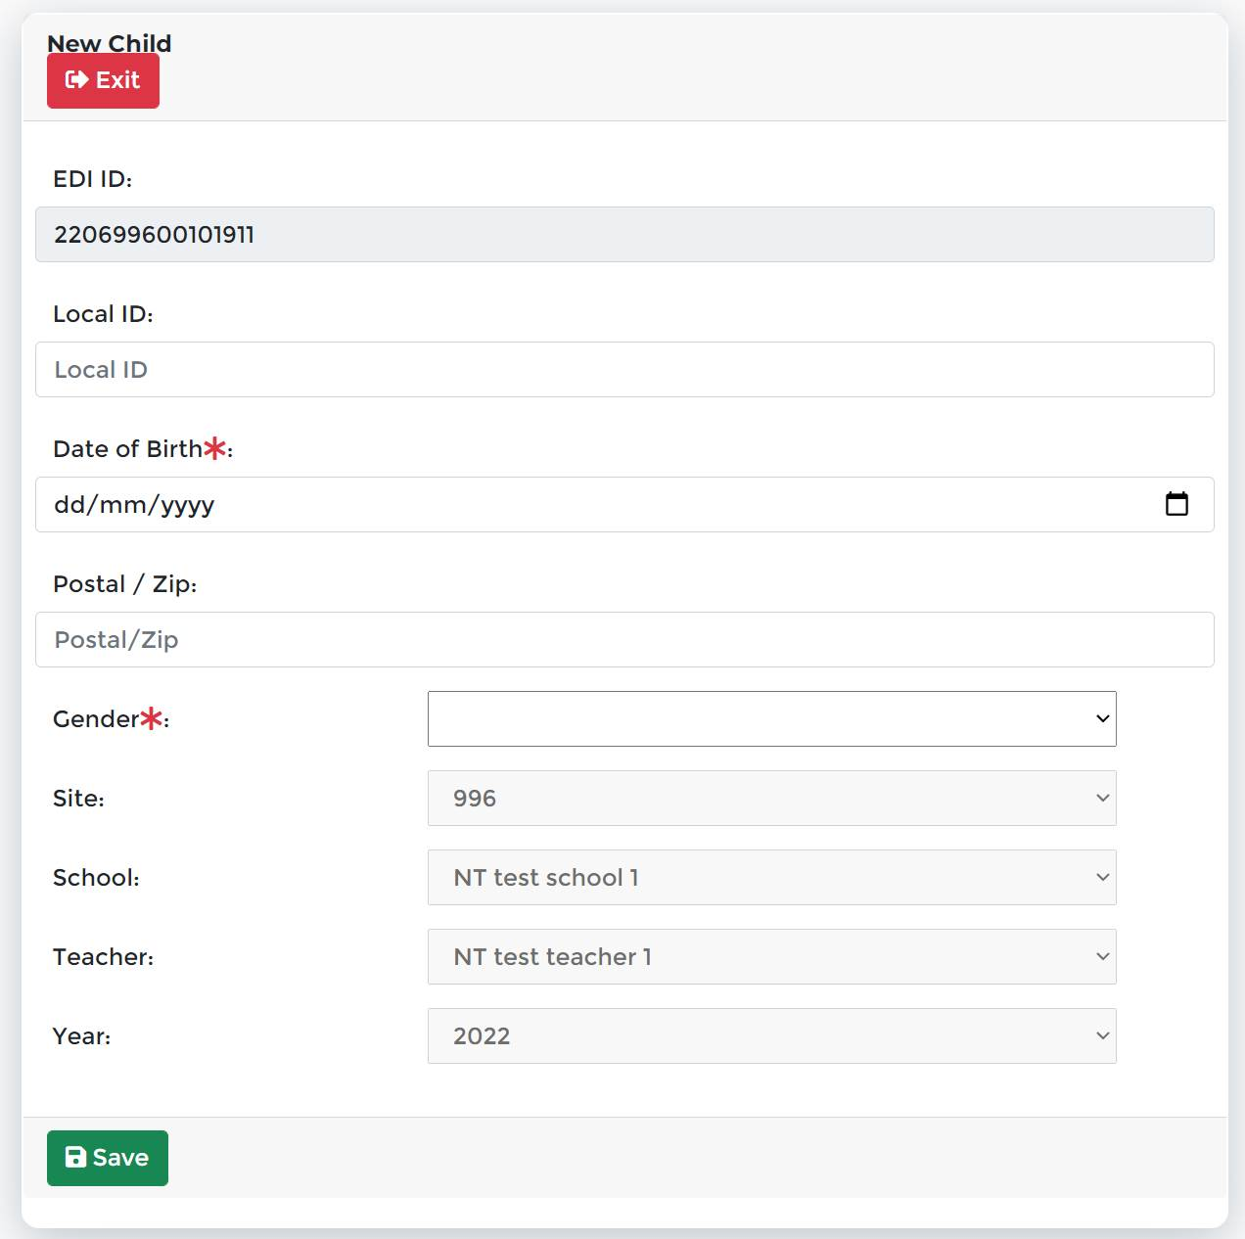
Adding a new student
The system automatically generates a new EDI ID for any new child added to the class list
Make sure to add the student’s Local ID before going into the child’s questionnaire. You won’t be able to enter it afterwards.
Remember to add all of the student’s information on the Demographics page
Click Save
Notes:
You will need to add the student’s local ID. Once you click Save, you will not be able to add it later on. If teachers do not know the student’s local ID, they will need to contact their local coordinator for that information. The Offord Centre only generates the EDI IDs, not the local IDs.
You will also need to add the student’s date of birth, gender, and postal code
The site, school, teacher, and year will automatically be generated for you,.
Once you have filled in all the student's demographic information, click Submit

Slide 66

Deleting a student
The e- system will not allow you to delete any student from your class list. No student should be deleted from your class list.
If a student has never been in your class, please contact the Offord Centre to have the EDI ID removed.
If a child has moved away, you should select either “moved out of class” or “moved out of school” in the student status question of the demographics section.
Notes:
The e-EDI will not you to delete students from your class list. No student needs to be deleted from a class list.
If a child has moved away, a teacher should select either “moved out of class” or “moved out of school” in the student status question of the demographics section.

Slide 67

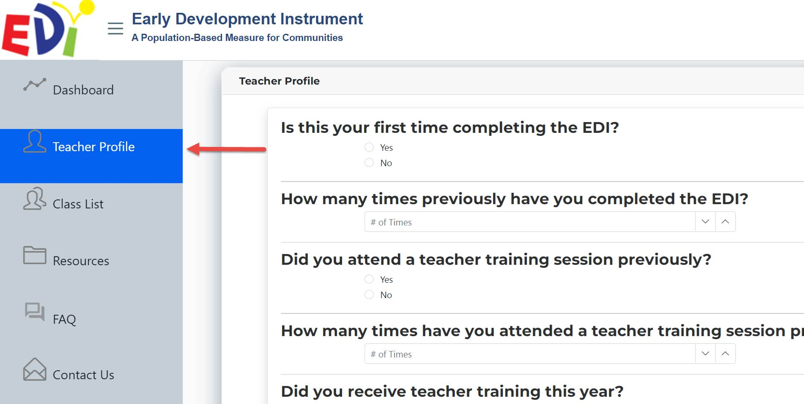
Done?
Remember to fill out your Teacher Profile Form (located on the Dashboard Menu)
Notes:
Once you are finished completing the EDI questionnaires for your students, please remember to fill out your Teacher Profile forms, which are located on the main menu, under My Profile. This information is completely anonymous and confidential and will not be associated with your questionnaires in any way. We do encourage you to complete this, as it provides valuable information to help us improve your EDI experience.

Slide 68

Privacy & Confidentiality
All information collected is kept completely confidential & is used for research purposes only
No child or teacher is EVER identified in our reporting
Notes:
You should know that all information that will be collected during the EDI implementation will be kept completely confidential and will be used for research purposes only.
No child or teacher is ever identified in our reporting.

Slide 69
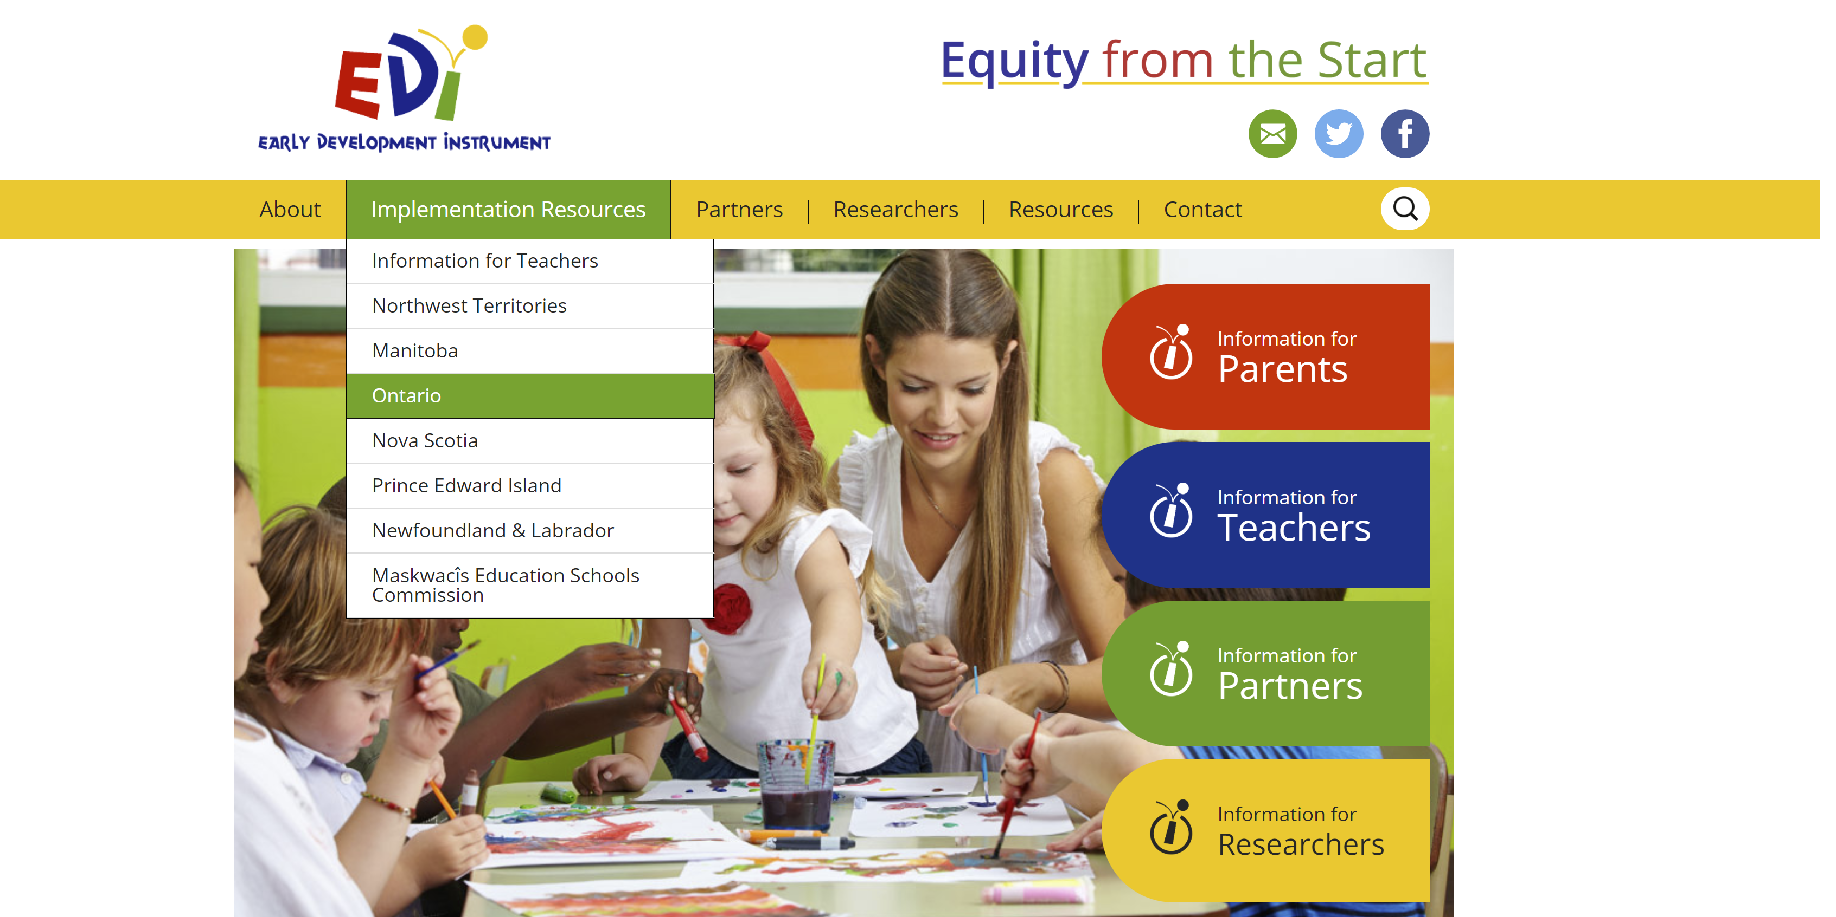
Resources
website: edi.offordcentre.com
Notes:
Please note that the EDI Team’s website is always available to you with a host of EDI resources including territory specific resources such as the EDI Guide and EDI Teacher’s manual.
You can visit the website at www/edi.offordcentre.com.
Select ‘Implementation Resources’ from the option list across the top, then select your province.

Slide 70
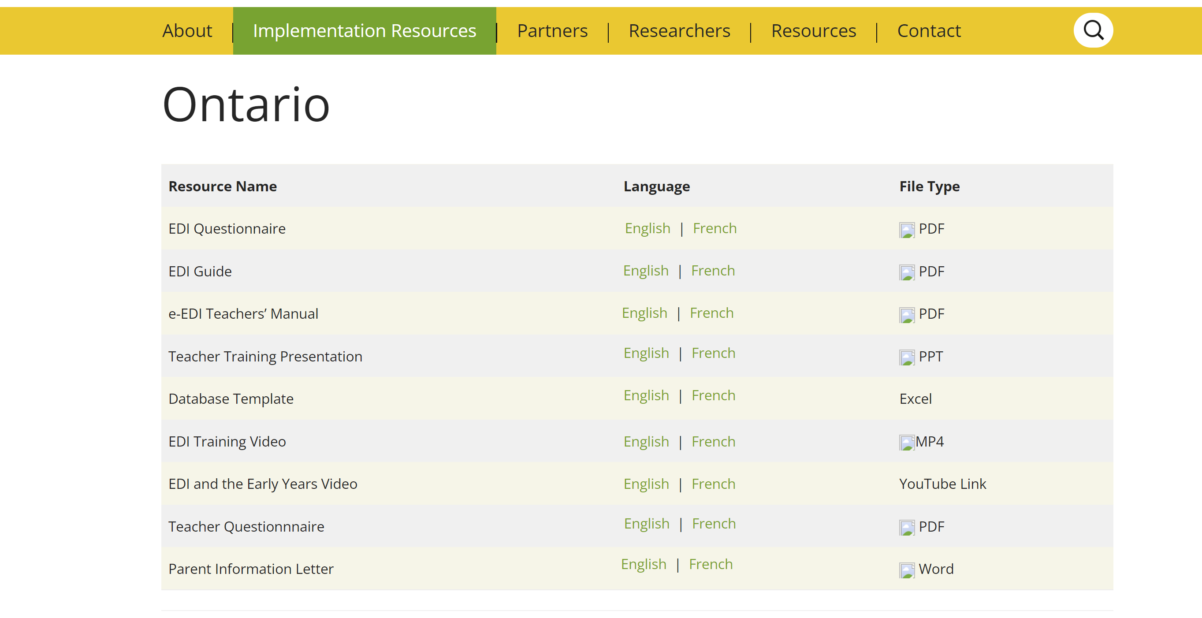
Resources
Notes:
Here you can also find a copy of the Parent Information Letter. This letter has been approved by the McMaster research ethics board. The EDI project utilizes a passive consent model. This means that parents are to be notified that this research is taking place and they have the opportunity to withdraw their child's participation at any point in the process. Unlike active consent parents are not required to sign anything or to return a permission slip to teachers or schools. Parents simply need to be informed that this research is taking place in their school board.

Slide 71


For questions, please contact your local coordinator or the Offord Centre for Child Studies at:
webmaster@e-edi.ca
rasope@mcmaster.ca
Notes:
This concludes the information and training session.
If you have any questions, please do not hesitate to contact your local EDI coordinator or the Offord Centre for Child studies at the email address located on the screen.
We value your participation in the EDI implementation and are happy to answer any and all questions you may have.

Slide 72


Thank You! rasope@mcmaster.ca
Notes:
Thank you for watching and for taking part in this year’s EDI implementation.
Without your participation this research would not be possible.
We greatly appreciate your invaluable contribution! We wish you all the best with the completion of the EDI questionnaires.

