Slide 1
The Early Development Instrument
(EDI)
EDI Teacher Training
Newfoundland
Notes:
Hello everyone and welcome to the EDI Training Sessions. Thank you all for joining today’s training session.

Slide 2
Outline
Early Childhood Development
The Early Development Instrument (EDI)
e-EDI Teacher Training
Completion of EDI Questionnaire
Notes:
Here you can see an overview of today’s training session.
This presentation will provide you with an overview about the importance of the early years and why we need to measure them.
We will discuss some information about the creation and importance of the EDI,
This will be followed by specific training to teacher you how to complete the EDI questionnaires online.
Lastly, will get everyone logged into our system and have all teachers complete their questionnaires this afternoon. You can complete the EDI questionnaires as your own pace. It may not take you all afternoon to complete the questionnaire.

Slide 3

Early Years Matter
They set the stage for further development
Notes:
A growing body of research on children between the ages of 0-6 years and their families is accumulating into strong evidence that the early years represent the most significant time period in an individuals lifespan.
Basic neuroscience has demonstrated that the interaction between a child’s genes and his or her early environment has a profound impact on later outcomes.
This is of significance not only for each of us individually but also to us as a society. The health of our population affects our collective social and economic well-being.

Slide 4

Early Years Matter
Child’s experiences in the early years of life influence the way the children’s genes are expressed
Child’s ability to learn when they enter school is strongly influenced by the brain development that takes place in the early years
Notes:
Children’s experiences in the early years of life influence the way the children’s genes are expressed, for example in language or regulation of emotions.
A child’s ability to learn when they enter school is strongly influenced by the brain development that takes place in these early years.
Early child development, in turn is a life long determinant of health, well-being, and learning skills.

Slide 5
‘Sensitive periods’in early Brain Development
Binocular vision
Central auditory system
Habitual ways of responding
Language
High
Emotional control
Symbol
Peer social skills
Relative quantity
Sensitivity
Low
0
1
2
3
4
5
6
7
Years
Notes:
This graph illustrates the sensitive periods for different aspects of children’s brain development.
Periods of high sensitivity in all aspects peak during the first three years of life.
Brain and biological development depends on the quality of stimulation in the infant’s environment—at the level of family, community, and society.

Slide 6
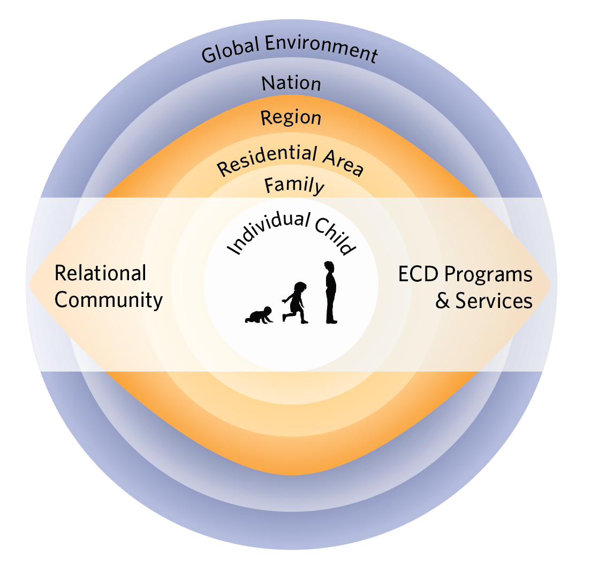
Early Years Matter
All children are born ready to learn
Parents, families, neighbours and communities need to work together to ensure children’s readiness to learn in school environment
Notes:
Diagram based on Bronfenbrenner’s concentric circles, borrowed from HELP
Children are born ready to learn, but are they ready to learn at school?
Early Childhood Development matters to children, families, and communities on multiple outcomes
everyone must work together to ensure that children’s early life experiences have a positive influence on their subsequent life chances, including success at school.
Means creating the best conditions for children to thrive equally in all areas of development, including physical, social, emotional, language, and cognitive domains.

Slide 7
Key Message
The later you attempt to change a trajectory the more energy that is required
An effort in the early years when neural systems are most plastic and susceptible to influence can have long-lasting positive outcomes
Notes:
In summary, the early years are critical
the later you attempt to change a trajectory, such as a child’s developmental trajectory, the more energy will be required to achieve the change.
Influence children in the early years when the neural systems are the most flexible, we can achieve longer-lasting positive outcomes.

Slide 8
Why Measure?
Developmental Status
Intervention and Prevention Programs
Greatest Need
Making a Difference
Notes:
End of Early years matter section
The next section: why it is important to measure children’s developmental health.
Questions that measurement can answer:
We need to know the developmental status of our young children,
We need to know when ther intervention and prevention programs help children and their families,
We need to know whether these programs are helping those at greatest need,
And lastly, we need to know whether we are making a difference in children’s lives.

Slide 9

“No Data, No Problem,
No Action”
Alfredo Solari
Notes:
No data, can’t answer the question about developmental status
Can’t identify current problems
Can’t take action to improve children’s lives

Slide 10

Of Canada’s kindergarten children are vulnerable
Over 25%
Notes:
Over the last decade, researchers have worked with kindergarten teachers across Canada to monitor the development of young children starting school.
This population-level research shows that, today, over 25 % of children entering kindergarten are vulnerable in at least one developmental domain.

Slide 11

A large number of children at a small risk for school failure may generate a much greater burden of suffering than a small number of children with a high risk
(Based on Rose 1992, Offord et al. 1998)
Notes:
Not only is measurement important, but population-based measurement of children’s development health helps to take a temperature of how all children are doing.
By using population-based measures, we are able to highlight groups of vulnerable children that may have not otherwise been noticed.
Population based data enables us to develop universal prevention strategies that will be able to help the greatest number of children.

Slide 12
Vulnerability by Family Income (N=1799)
Source: NLSCY/UEY 1999/2000; EDI 1999/2000
Notes:
This graph actually illustrates this idea perfectly of highlighting children that might have otherwise been overlooked.
This is a graph of the percentage of children that are vulnerable by social economic status.
We can see that children from very poor families have a high percentage of vulnerable children, however the next graph…

Slide 13
Numbers of children classified “Vulnerable”
Source: NLSCY/UEY 1999/2000; EDI 1999/2000
Notes:
The next graph is the same chart with the counts of children, instead of percentage,
Actually a much higher number if vulnerable children in the well-off group,
might have otherwise overlooked if we focused only on helping those children from disadvantage families.

Slide 14
% of Children
Gap
Mean
Low
High
Outcome measure
Notes:
Results of any outcome measure, like the EDI, can be represented by a distribution curve, such as this one, which often resemble a bell.
Most children fall somewhere in the middle, as shown by the two red lines.
Small percentages of children have very low scores, indicating difficulties, that fall on one extreme side of the curve.
Also, small percentages of children have very high scores, indicating excellence, that fall on the other extreme side.
The larger the gap is between the two extreme sides, the more inequity there is in a population.

Slide 15
Targeted strategies decrease curve for vulnerable
% of Children
Gap stays the same
Mean
Low
High
Outcome measure
Notes:
In an effort to help children with highest needs, targeted, individualized strategies aim to help with interventions tailored to their needs.
This decreases the curve for the most vulnerable populations, meaning less children are vulnerable,
gap for typically developing children remains the same.

Slide 16
Universal strategies-entire population moves
Targeted strategies decrease curve for vulnerable
% of Children
Gap narrows
Mean
Low
High
Outcome measure
Notes:
Our goal is to shift the curve of the outcomes towards the higher end.
Universal strategies, aimed at all children, shift the whole curve, thus narrowing the gap between the low and high end.
Meaning, children’s developmental health as a population improves, and we don’t focus on just one particular group of children.

Slide 17

Notes:
And this is what the EDI is meant to do.
The instrument was developed in Canada between 1997 and 2000, to measure the holistic development of each child in the population.
The data gathered from the EDI collection allows a child development outcome to be reported at the same indicator level as birth rate or survival rate.
The goal of the EDI is to measure children’s developmental health at school entry.
This refers to the child’s ability to meet the task demands of school, such as:
being comfortable exploring and asking questions,
listening to the teacher,
playing and working with other children, and
remembering and following rules.
In short, it is the ability to benefit from the educational activities that are provided by the school.

Slide 18
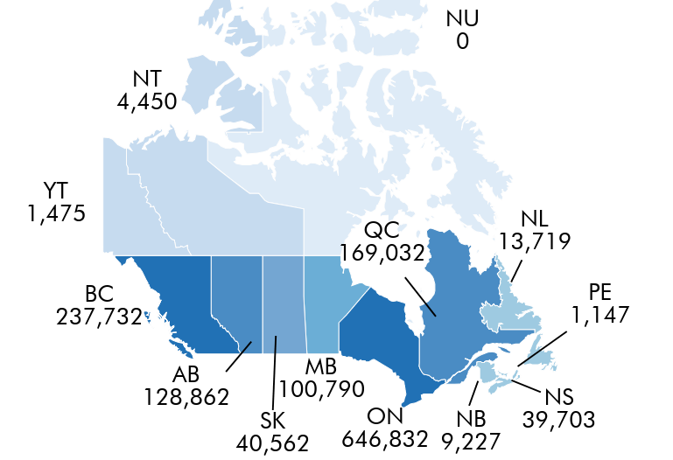
EDI in Canada
EDI Implementations in Canada
Notes:
To date, EDI data has been collected province or territory-wide in 10 provinces and 2 territories in Canada, for over 1.2 million kindergarten aged children since 2004. Some provinces and territories have had multiple EDI collections

Slide 19
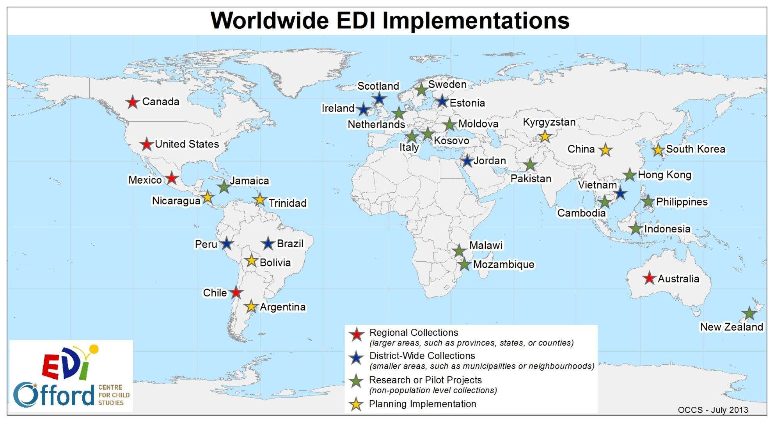
Notes:
This map demonstrates of the global reach of the EDI and the countries in which the EDI has been implemented. The EDI has been collected internationally at different levels.

Slide 20

Purposes of the EDI
Notes:
EDI has several main purposes:
reporting on populations of children in different communities over time

Slide 21
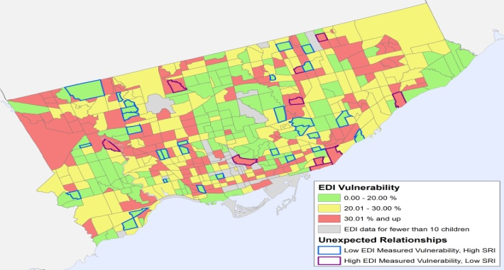
Purposes of the EDI
Notes:
The EDI has several main purposes:
identifying where the needs and strengths are greatest

Slide 22

Purposes of the EDI
Notes:
The EDI has several main purposes:
predicting children’s academic success in elementary school

Slide 23
Purposes of the EDI
Notes:
The EDI has several main purposes:
providing a picture of what early learning looks like at the community level, and,
helping to identify gaps in early development programs and services.

Slide 24
The EDI is……
104 item questionnaire
Completed by teachers
A population (or large group) measure
A way to understand trends in the development of primary children
The EDI is not…..
An individual child or diagnostic measure
A way to evaluate teachers
Notes:
The EDI is a:
104-item questionnaire that is completed by teachers.
tool to measure children’s development health at a population or group level, and
it gives the opportunity to understand the changing trends that are occurring.
The EDI is not:
a diagnostic measure, and should not be used for an individual child assessment.
evaluation of teachers.

Slide 25

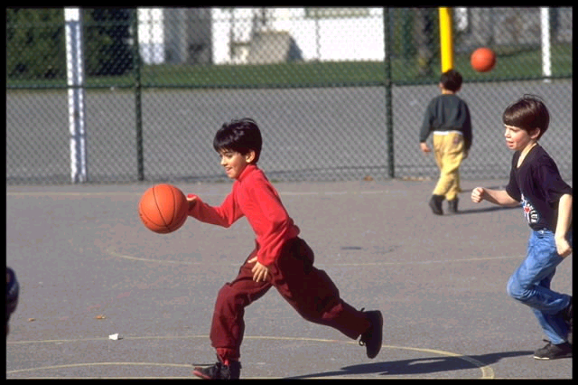
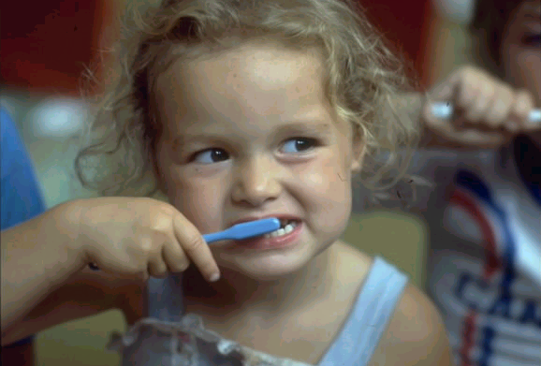
Physical Health &
Well-Being
Subdomains:
Physical readiness for school day
Physical independence
Gross and fine motor skills
Notes:
The EDI assesses children’s developmental health when they enter school by looking at five key areas of child development. These five subdomains are also further broken down into 16 subdomains.
Physical Health & Well-being
Physical readiness for school day (including arriving to school hungry)
Physical independence (established hand preference)
Gross and fine motor skills (being able to manipulate objects)

Slide 26


Social Competence
Subdomains:
Overall social competence
Responsibility and respect
Approaches to learning
Readiness to explore new things
Notes:
Social competence
Overall social competence (ability to get along with peers)
responsibility and respect (follows rules and instructions)
approaches to learning (listens attentively)
readiness to explore new things (curious about the world)

Slide 27
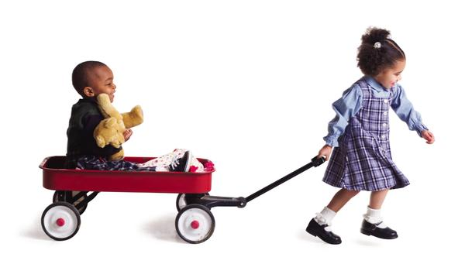

Emotional
Maturity
Subdomains:
Prosocial and helping behaviour
Anxious and fearful behaviour
Aggressive behaviour
Hyperactivity and inattention
Notes:
Emotional Maturity:
Pro-social and helping behavior (try to help someone who has been hurt)
Anxious and fearful behavior (upset when left by parent)
Aggressive behavior (gets into physical fights)
Hyperactivity and inattention (can’t sit still, restless)

Slide 28

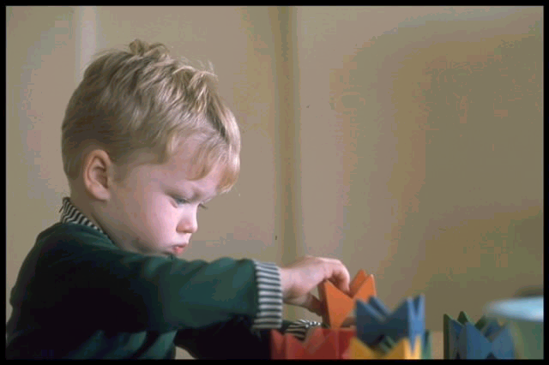
Language & Cognitive Development
Subdomains:
Basic literacy
Interest in literacy/numeracy and memory
Advanced literacy
Basic numeracy
Notes:
Language and Cognitive development
Basic literacy (ability to handle a book)
Interest in literacy and numeracy, and uses memory (able to remember things easily)
Advanced literacy (able to read simple words)
Basic numeracy (able to count to 20)

Slide 29


Communication Skills & General Knowledge
Subdomain:
Communication skills & general knowledge
Notes:
Communication Skills and general knowledge and it is the only domain that only has one subdomain, which is also called communication skills and general knowledge.
Items in the domain include such things as skills to communicate needs and wants in socially appropriate ways, symbolic use of language, story telling, age-appropriate knowledge about the life and world around.

Slide 30
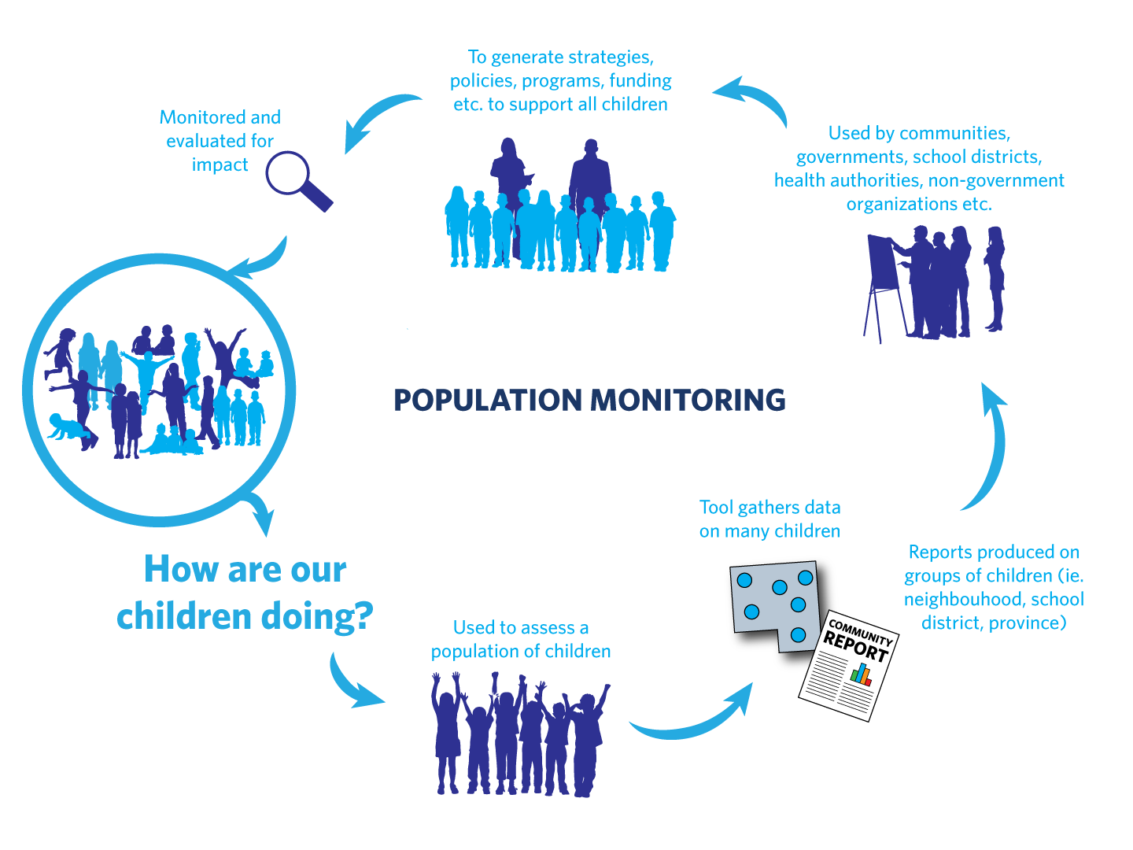
Notes:
The EDI helps to answer the question – how are we doing for our youngest population?
use the EDI to gather data on our children.
use this data to report on groups of children, such as neighbourhoods, schools, or communities.
Communities and governments use this data to generate and drive strategies, policies, programs and funding opportunities to support all children.
We then need to monitor and evaluate the impact of these strategies, therefore we complete the EDI again. And the cycle continues…

Slide 31
In terms of what we can influence
Early experiences
Developmental outcomes
Success in school
Inform
Predict
EDI results
Notes:
Through this EDI cycle, we are able to gather information about children’s experiences in the early years, monitor their developmental trajectories and outcomes, and help to predict later school success.

Slide 32

The Early Development Instrument
(EDI)
e- Teacher Information & Training Session
Notes:
The next part of this session is designed to provide teachers with the necessary information in order to complete the EDI.
This training session is intended for teachers who have never completed the EDI before, as well as for those who have.
If, along the way, you have any questions, an email address will be provided at the end of the video. Do not hesitate to contact us.

Slide 33



Overview
Information about the e- process
How to complete the online questionnaire
Notes:
The main goal of this section is to provide information on how to complete the e-EDI.
This presentation is divided into two main sections.
The first section covers some general information about the e-EDI process
second section will cover the online completion of the questionnaires, section by section.

Slide 34

Getting Started
Teacher should have access to and review the following items:
  EDI Guide
  e-EDI Teacher Manual
  e-EDI Teacher log-in
  Local class list
Notes:
Teacher should receive and review the following important documents.
EDI Guide and an e-EDI teacher’s manual.
e-EDI teacher log-in and password from the OCCS and a local class list for every class you teach (for example, a morning class and an afternoon class).
Local coordinators will have a master list of all teachers login and password information. All teachers should have been provided with a local class list which will contain the demographic information for each of your students as well as their local identification number and their first and last names. Teachers will use this class list to match up your students with the e-EDI class list to ensure that you are completing the questionnaire on the correct student.

Slide 35


EDI Guide & Teacher’s Manual
They are intended to facilitate completion of the
The Manual provides steps to guide the on-line completion of the questionnaires
The Guide provides more detailed information about each question in the
Notes:
The EDI Guide and teacher’s manual are intended to facilitate completion of the EDI and should be read before starting the completion of the EDIs.
The Teacher’s manual provides steps to guide you through the online completion of the EDI questionnaires, while the Guide provides more detailed information about each question within the EDI. These are two very useful tools to help you complete the questionnaires more efficiently and more accurately.

Slide 36


Before You Begin the e-EDI
Receive your training!
Get your login & password
Review the e- questions
Have your class list handy
Ensure that all the children in your class(es) have a local ID & are included on your list
Review any background materials (e.g.
Guide, Teacher’s Manual)
If applicable, list students whose parents/guardians have refused to participate
Notes:
Before you being completing the EDI on your students, you will need to receive training on how to complete the questionnaire.
You will also need to get your login and password. Your local coordinator will provide you with a login and password for the e-EDI system when you are given the EDI class list.
Please make sure to review the e-EDI questions and ensure that you feel reasonably comfortable with the questions that will be asked about each student.
Have your class list available. Please make sure to have your class lists with you when you start completing the EDI, in order to match your students’ local IDs, gender, and birth dates to confirm that you are entering information for the correct student.
Ensure that all the children in your class(es) have a local ID and are included on your list. If any students are missing, they will need to be added.
Review any background materials, such as report cards, student file, Kindergarten Registration or other information that might help you to answer the questions for each student. Also, please make sure you read the EDI Guide and the e-EDI teacher’s manual. As mentioned in the previous slide, these materials will help you complete the EDIs more efficiently and more accurately.
If applicable, list students whose parents/guardians have refused to participate. Letters should have been sent to parents ahead of the scheduled time for EDI data collection.

Slide 37


Tip #1
Read the entire Guide once before starting on the questionnaires
After having read the Guide, please consult it if you have any doubts about a given question
Have the e- Teacher’s Manual with you when completing the questionnaires
Notes:
Tip #1: Please ensure you read the entire EDI Guide once before starting on the questionnaires. That way, if you have any questions about anything, you will be able to get answers to them before starting.
Also, please have the e-EDI teacher’s manual with you when completing the questionnaires. It provides step-by-step instructions on how to complete the questionnaires using our online system.
Having these documents with you will help the whole process run more smoothly.

Slide 38
Implementation Timelines & Deadlines
Teachers receive e-
training
Teachers complete the questionnaire online
Teachers lock & submit each child’s questionnaire as they are completed
Today!
February 1st to March 31st
February 1st to March 31st
Notes:
Here is a timeline for EDI completion.
Receive EDI training.
You will then until March 31st to complete the EDI and lock and submit each questionnaire.
A February/March implementation is ideal for many reasons.
First, by February/March of the school year, teachers will have grown to know their students very well and can easily and efficiently complete the instrument.
Secondly, some children may take longer to acclimatize to the school environment and may therefore need a longer period of time to adjust and function well.
Another main reason that the EDI is implemented in February/March is for comparability purposes. The EDI is implemented in this time frame across Canada and all over the world.

Slide 39

Time
About 20 minutes per questionnaire
After completing a few, it should take closer to 10 minutes per questionnaire
s for best students and struggling students are completed more quickly… middle ground students require more thought.
Notes:
It should take you approximately 20 minutes to complete the questionnaire, per student.
After completing the EDI for a few students though, it should take closer to 10 minutes per student.
Based on teacher feedback we have received, you will most likely complete the EDI in less time for your best students, as well as for those who are struggling. The students who are in the “middle ground” will most likely require more thought and as a result will take longer to complete.

Slide 40
Tip #2
Due to the “learning curve” involved, it is considerably more efficient to complete all the questionnaires in one sitting*
* One sitting may involve 2 or 3 consecutive days, depending on the number of students you have
Notes:
Due to the “learning curve” involved in completing the questionnaires, it is considerably more efficient to complete all the questionnaires in one sitting.

Slide 41

How to complete the e- questionnaires

Slide 42


Accessing the e-EDI
In your Internet browser type in:
www.e-edi.ca
Notes:
To access the e-EDI, type in www.e-edi.ca in your Internet browser (such as Internet Explorer, Google Chrome, Firefox, etc). You may even want to bookmark it for the future.

Slide 43

Signing In
Teacher’s email here
Make sure you select the language you want to work in
Teachers password here
Notes:
Using the login and password information that was provided to you, enter the information in the appropriate fields.
Make sure you select the language you wish to work in. Click the login button or hit the Enter key to log in.
You have the option of selecting “save my settings”. By doing this, the system will remember your username (aka email) the next time you visit the website. If you are using a public computer, we do not recommend selecting this option so you will need to unclick the box located under the password field.
Once you are logged in, you will only be able to see your own classes and students information. You will not have access to other teachers’ class lists and they will not be able to access yours.
In the event that teachers co-teach a class, it is recommended that only one of the teachers complete the EDIs for all their students. The reason for this is to try and keep things as consistent as possible.

Slide 44
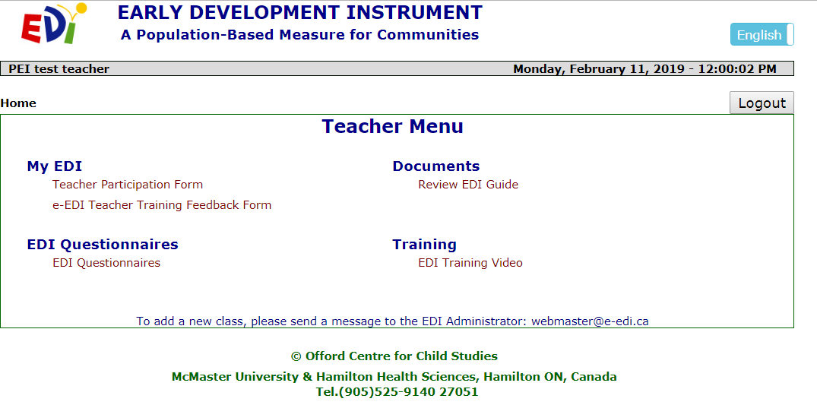
Teacher Menu
Please read the Guide before starting. To access the Guide, please click here & a PDF version will appear
Notes:
After logging in, this is the screen that will appear – it is your main homepage.
There are three main areas: Under My EDI, you can complete the teacher participation and teacher training feedback forms.
Under Documents you will find a link to an electronic copy of the EDI Guide. Please make sure to read through it before starting to complete the questionnaires.
There is also a link to the EDI Training Video. This video can be watched by any teachers who want a refresher and takes about 20 minutes to view.
To start completing the EDI, select EDI Questionnaires.

Slide 45

General Instructions
Responses should be based on your observations of the students which reflect his/her current developmental status.
Exception: Section C
  Responses should be based on observations of the students now, but using the time since the beginning of the school year as a frame of reference.
Notes:
When completing the EDI, please keep in mind that your responses should be based on your observations of your students which reflect their current developmental status.
The only exception is Section C. Your responses should be based on your observations of the child now, but you should use the time since the beginning of the school year as a frame of reference.

Slide 46

General Instructions
Use “Don’t know” as a last resort.
Questionnaires received with too many ‘I don’t knows’ cannot be used in the analyses.
If you have not seen a child exhibit a particular behaviour, select Never or Not True (not “Don’t Know”)
Notes:
Please refrain from using the “don’t know” response.
Questionnaires received with too many “I don’t knows” will not be considered valid and will be excluded from the analyses.
If you have not seen a child exhibit a particular behaviour since the beginning of the school year, the correct answer is Never or Not True (and not Don’t Know)

Slide 47
EDI Questionnaires
Click here to access your class list & questionnaires
Notes:
To get started on your EDI questionnaires, click on EDI Questionnaires from your homepage. This will bring you to your class list(s) and questionnaires.

Slide 48
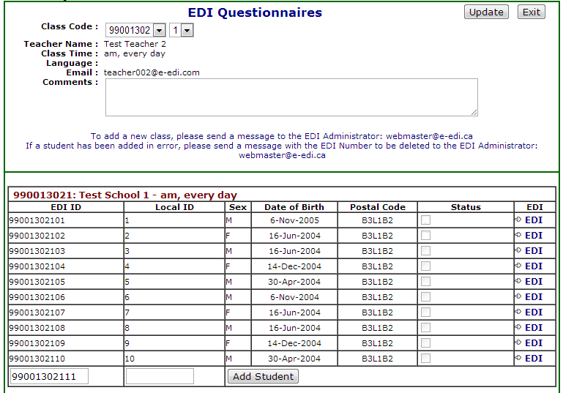
Class list(s)
Class List
Notes:
After clicking on EDI Questionnaires, you will be redirected to your class lists.

Slide 49
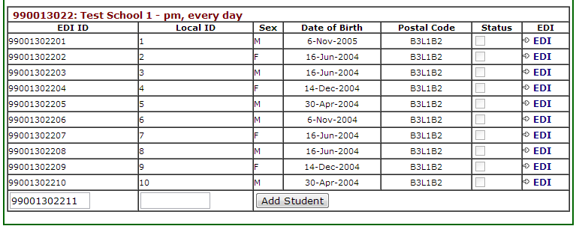
Step 1: Identify the Child
Match the corresponding Local ID with the Local class list (which contains children’s names) to ensure you are thinking about the right child.
** For privacy issues, the children’s names do not appear anywhere on the questionnaire
Notes:
Your class list allows you to see each student’s EDI ID as well as their local ID, their gender, date of birth and postal code.
No student names appear on the questionnaire label.
Using your local class list (which contains children’s names) and the e-EDI class list, match the corresponding local ID to ensure you complete the questionnaire on the correct child.
For privacy reasons, children’s names do not appear anywhere on the questionnaire.

Slide 50
Entering into the Questionnaire
To access a questionnaire, select one of the flashing blue EDIs on the right-hand side of the screen.
Notes:
To complete a questionnaire for a student, click on the flashing blue EDI icon located on the right-hand side of the screen.

Slide 51
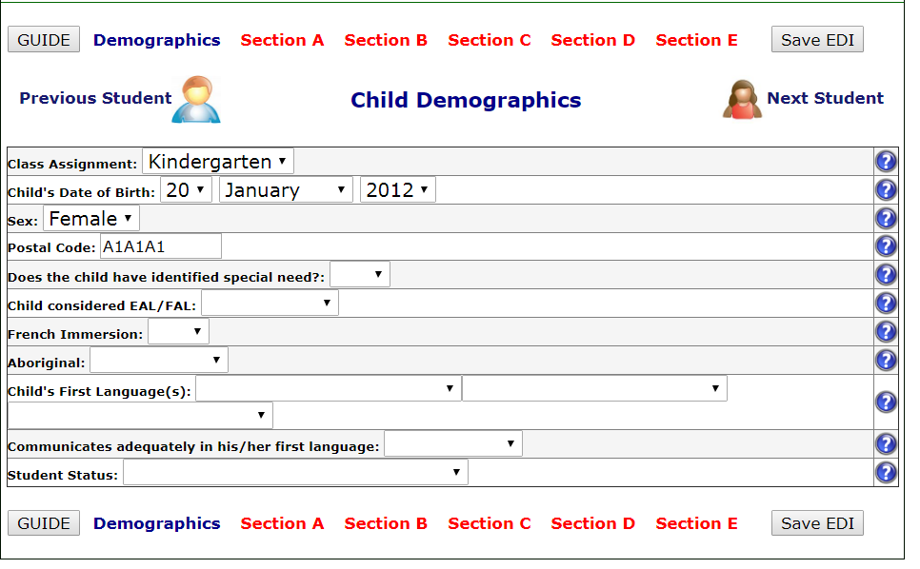
Child Demographics
* For province/territory-specific questions, please refer to your Guide
Notes:
In this section, the first few questions should already be prefilled (with the exception of newly added students, which we will get to later in the presentation).
For the remaining questions, please select the appropriate response.
You will notice that the answers are in the form of a drop-down list.
You have the option to complete this section and then move on to the next student by clicking on “Next student” or continuing to another section for this same student by selecting one of the sections in red located at the top and bottom of your screen.
We highly recommend you complete a questionnaire in full for one student before moving on to another. This method is much more efficient.

Slide 52
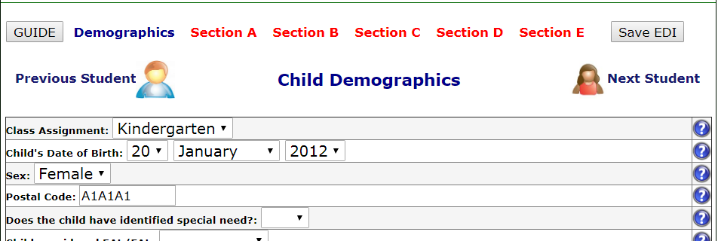
Missing or Incorrect Information
If any of the information is incorrect or missing, enter the correct information in the Child Demographics section
Click Save EDI
Notes:
Please ensure the demographic information is correct (especially for the prefilled questions).
In the event the information for a given question is incorrect or missing, please enter the correct information and click on Save EDI.

Slide 53
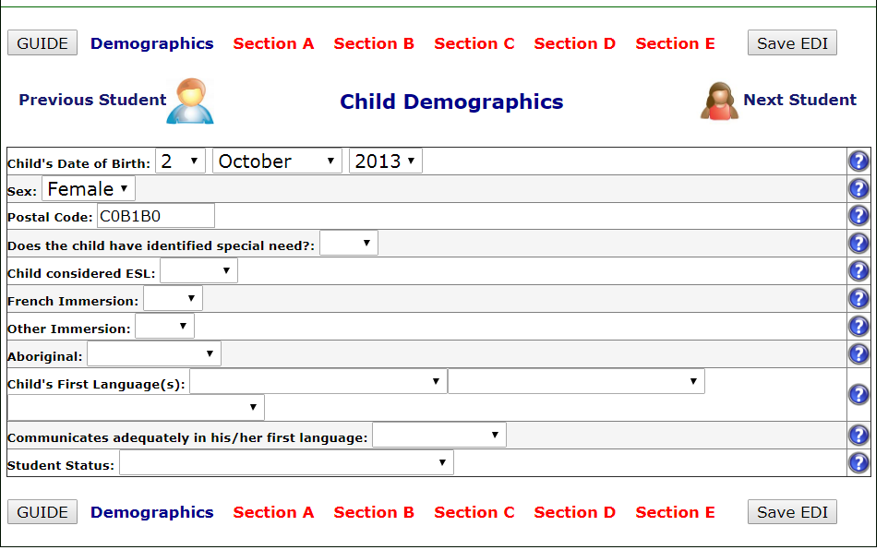
Sections A-E of the EDI
To access a specific section of the EDI, click on one of the sections listed in red near the top of your screen
Notes:
To access the various sections of the EDI, all you need to do is click on one of the sections listed in red near the top (or bottom) of your screen.

Slide 54
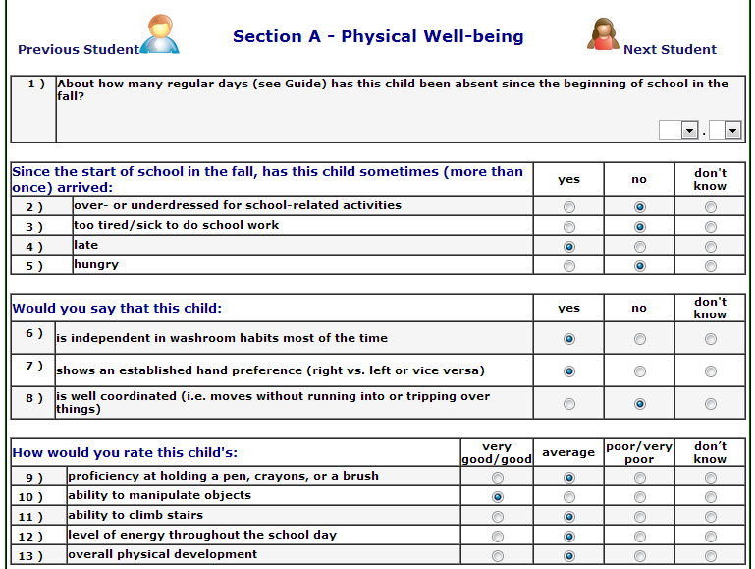
Sections A-E of the EDI
Complete Sections A to E by selecting the appropriate response for each question
Notes:
Complete each section of the EDI by selecting the appropriate response for each question.
If you are unsure about what a question is referring to, please consult the EDI Guide.
If you want (or need) to change your answer, you can do so by clicking on another option.
If you hold your cursor over one of the response options (the little circles), the response choices will appear.

Slide 55
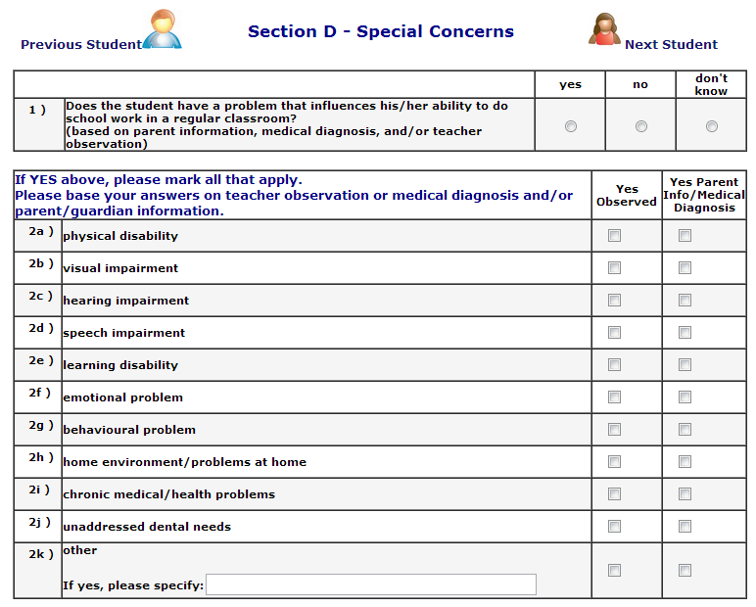
Section D
Notes:
Section D refers to any special concerns about a particular child.
Please refer to your Guide for the definition.
Please note that you may choose more than one answer in question 2. However, your answers to question 2 must be consistent with your answer in question 1.
If you have responded that the student has a problem that influences his/her ability to do school work in the classroom by selecting « yes » to the 1st question, you must select at least 1 of the special concerns in question 2. Please answer these questions to the best of your abilities.

Slide 56

Section E
Answer these questions to the best of your knowledge
Use data from the students’ records, if available
If you don’t know the answer to the questions, please indicate “don’t know”
Once completed, click Check for Completeness
Notes:
Section E includes questions related to children’s pre-school experiences.
For these questions, please answer to the best of your knowledge.
Feel free to use data and information from the students’ records, if available.
In the event you don’t know the answer to a question, you can certainly select “don’t know”.
Unlike the other sections, selecting “don’t know” in section E will not render your questionnaire invalid.
Once you have completed all the sections, click check for completeness located at the top (and bottom) of the screen.

Slide 57
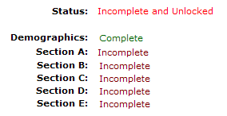

Finishing & Checking
After clicking Check for Completeness, if the system tells you:
Go back to incomplete sections
and fill in any answers you missed
You are done!
Click
here
Notes:
Once you’ve clicked Check for Completeness, the e-EDI system will either tell you that you have some sections that are incomplete or that all sections have been successfully completed.
In the event of incomplete sections, you will need to go back and answer and questions you may have missed. To do that, simply click on the word incomplete beside the corresponding section.
If you have successfully completed all sections, you are now done and can click Finished/Submit to McMaster.
Don’t forget that you will have to do this for each student in your class.
Clicking Finished/Submit to McMaster after the last questionnaire will only submit that questionnaire and not the whole class.

Slide 58
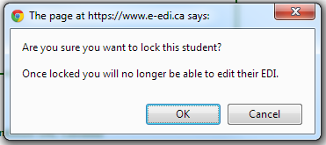

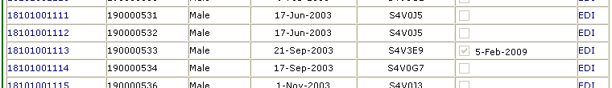
Finish/Submit a Questionnaire
You will get a message asking you if you are sure you want to continue with locking a child
If so, click OK. You will be returned to the Class Information page.
Notice how a date now appears beside the completed
Notes:
Once you click on Finish/Submit to McMaster, a message will appear asking you if you are sure you want to continue with locking the questionnaire.
If you are, click OK. By doing this, you will be redirected to the Class Information page where you can select another EDI questionnaire to complete.
Notice how a date now appears beside the completed EDI, under the Status column.
You will be able to tell which questionnaires you have locked and submitted this way.
All those without a date next to the flashing EDI still need to be completed and submitted.
Please note that once you lock a questionnaire you cannot reenter it without contacting Offord Center for permission.

Slide 59

Tip #3
Continuously save as you work!
After 15 minutes of inactivity you will
automatically be logged off the system and all your unsaved changes will be lost
Notes:
Please remember to continuously save as you work. Similar to bank websites, after 15 minutes of inactivity, you will automatically be logged off the system and all your unsaved changes will be lost.

Slide 60

Please Pay Special Attention to the Following Questions
Notes:
We will now identify specific EDI questions which require special attention.

Slide 61
Identified Special Needs
Identified Special Needs cannot be left blank!
Yes | No
Child identified already as needing special assistance due to chronic medical, physical, or mental disabling conditions, e.g., autism, fetal alcohol syndrome, Down syndrome Child requires special assistance in the classroom | * * Gifted or talented * * Please mark, instead, their special talents in Section B, questions 34-39 If you only suspect that the child may be suffering from a disabling condition, or the condition is not severe enough for the child to be classified as “special needs.” (Please indicate the problem in Section D of the questionnaire.)
Notes:
This question, located in the Child’s Demographics page must not be left blank.
If left blank the entire questionnaire will be omitted from analysis.
As a general guideline, you would respond yes to this question if the child has already been identified as needing special assistance due to chronic medical, physical or mental disabling conditions or requires special assistance in the classroom.
You would respond No to this question if you only suspect that the child may be suffering from a disabling condition or if the condition is not severe enough for the child to be classified as “special needs”.
Please refer to the general guidelines as well as the specific provincial guidelines when answering this question.

Slide 62


Student Status Question
Students must currently be in your class to do the
If you have selected a
response other than “In
class more than a month”…
… the system will tell you to
stop and lock and submit your questionnaire to McMaster.
Notes:
The student status questions is where you can identify students who are no longer in your class.
Students must currently be in the class
If you have selected a response other than “in class more than a month”, the system will tell you to stop, lock and submit your questionnaire to McMaster.
You will not be required to complete the rest of the questionnaire for that student.

Slide 63

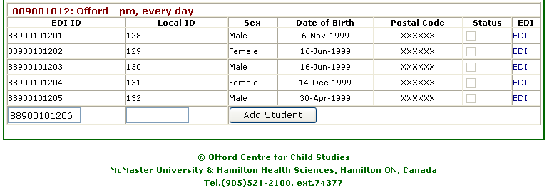
Adding a new student
The e- system automatically generates a new ID for any new child added to the class list
Make sure to add the student’s Local ID before going into the child’s questionnaire. You won’t be able to enter it afterwards.
Remember to add all of the student’s information on the Demographics page
Add student’s Local ID in here
Notes:
In the event one of your students does not appear on your class list, you can add them at the bottom.
The e-EDI system will automatically generate a new EDI ID for any new child added to the class list.
All you need to do is go to the very bottom of your class list where you will find a blank line (the EDI ID will be pre-filled).
You will need to add the student’s local ID here BEFORE clicking on Add Student.
Once you click on Add Student, you will not be able to add it later on.
If you do not know the student’s local ID, please contact your local coordinator for that information. As a general rule for this implementation……..
Make sure to fill in all the demographic information for this child on the first page of the questionnaire.

Slide 64
Deleting a student
The e- system will not allow you to delete any student from your class list.
In order to delete a student, please contact the EDI Coordinator at the OCCS (* information provided at the end).
Only students who have never been in your class should be deleted from your class list.
If a child has moved away, you should select either “moved out of class” or “moved out of school” in the student status question of the demographics section. You will then be prompted to lock and submit the questionnaire to McMaster without filling the rest out.
Notes:
Only students who have never been in your class should be deleted from your class list.
The e-EDI system will not allow you to delete any students from your class list.
Therefore, if you need to do so, you will need to contact the EDI Coordinator at the Offord Centre for assistance.
You will be asked to provide the student’s EDI ID you wish to remove from your list.
If a child has moved away, a teacher should select either “moved out of class” or “moved out of school” in the student status question of the demographics section. At that time, he/she will be prompted to lock and submit the questionnaire to McMaster and you will not be required to complete the rest of the questionnaire.

Slide 65

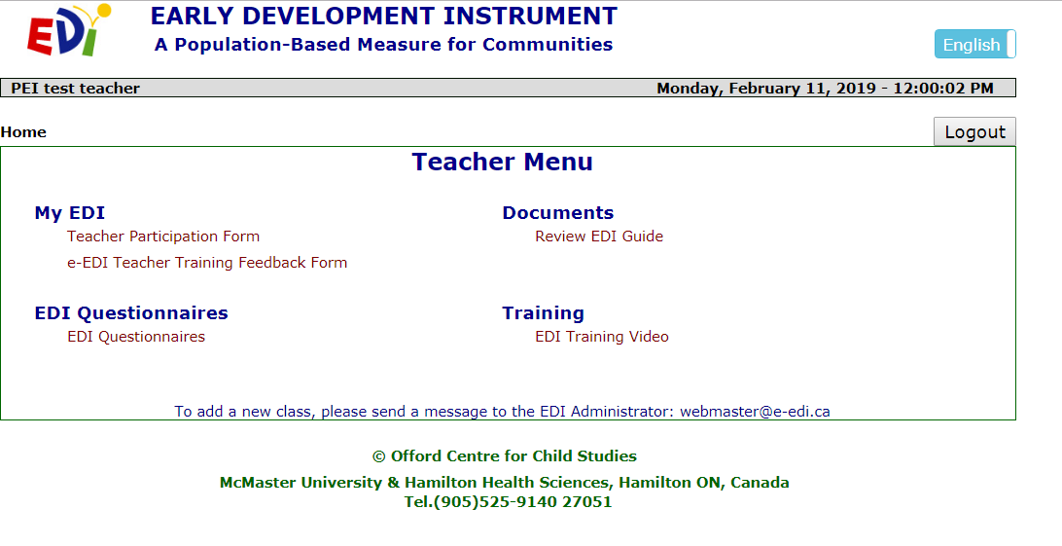
Done?
Remember to fill out your Teacher Participation
& Teacher Training Feedback Forms (located on
the main menu)
Notes:
Once you are finished completing the EDI questionnaires for your students, please remember to fill out your Teacher Participation and Teacher Training Feedback forms, which are located on the main menu, under My EDI. These forms are completely anonymous and confidential and will not be associated with your questionnaires in any way. We do encourage you to complete them, as they provide valuable information to help us improve your EDI experience.

Slide 66

Privacy & Confidentiality
All information collected is kept completely confidential & is used for research purposes only
No child or teacher is EVER identified in our reporting
Notes:
You should know that all information that will be collected during the EDI implementation will be kept completely confidential and will be used for research purposes only.
No child or teacher is ever identified in our reporting.

Slide 67

EDI Resources
https://edi.offordcentre.com/

Slide 68
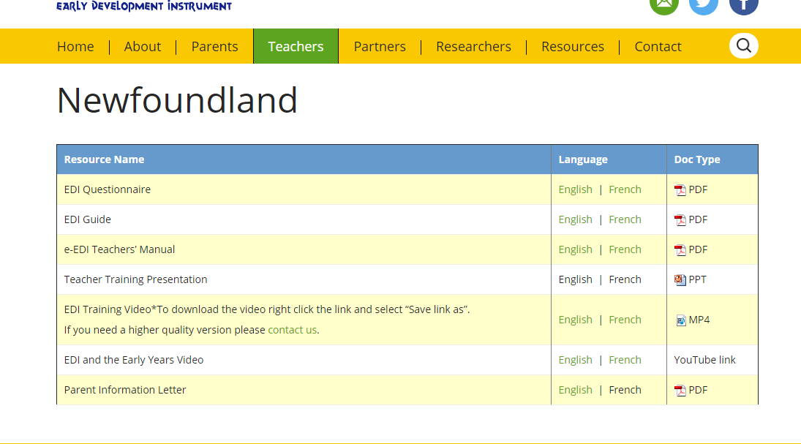
EDI Resources

Slide 69


For questions, please contact your local coordinator or the Offord Centre for Child Studies at:
webmaster@e-edi.ca
rasope@mcmaster.ca
reidwc@mcmaster.ca
Notes:
This concludes the information and training session.
If you have any questions, please do not hesitate to contact your local EDI coordinator or the Offord Centre for Child studies at the email address located on the screen.

Slide 70


Good luck & Thank You!
Notes:
Thank you for joining and for taking part in this year’s EDI implementation.
Without your participation this research would not be possible.
We greatly appreciate your invaluable contribution! We wish you all the best with the completion of the EDI questionnaires.
We value your participation in the EDI implementation and are happy to answer any and all questions you may have.

